Slide 1
Total Safety Value
Safety Training for New Recruits
Module TCG 1.2

Slide 2
Module objectives
At the end of this module:
  You will understand how safety at Total is a value and not just a priority.
  You will have succeeded in identifying, through your daily practices and your surroundings, the elements (decisions, practices, ways of working) that personify/testify to the value placed on safety by the Group.

Slide 3

Values = the foundations of our culture
  Value is on a level with ethics and corporate social culture (a culture is a set of values).
  A priority can change. A value is inherent and soaks into everything it touches.
  A value cannot be questioned, it is not discussed: compromise is not an option!
Value is universal beyond the differences between countries and cultures.

Slide 4
What about you?
How would you define your values?
Those which, when they are questioned by others or shaken by an event, shock you or affect you specifically.
Can you mention the actions you implement on a daily basis that result directly from your values (family life, studies, professional life, etc.)?

Slide 5
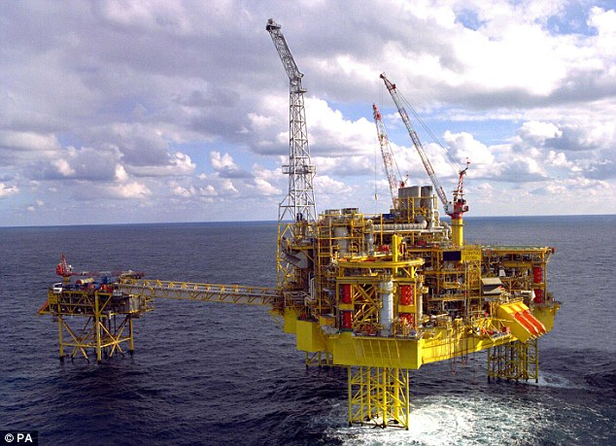
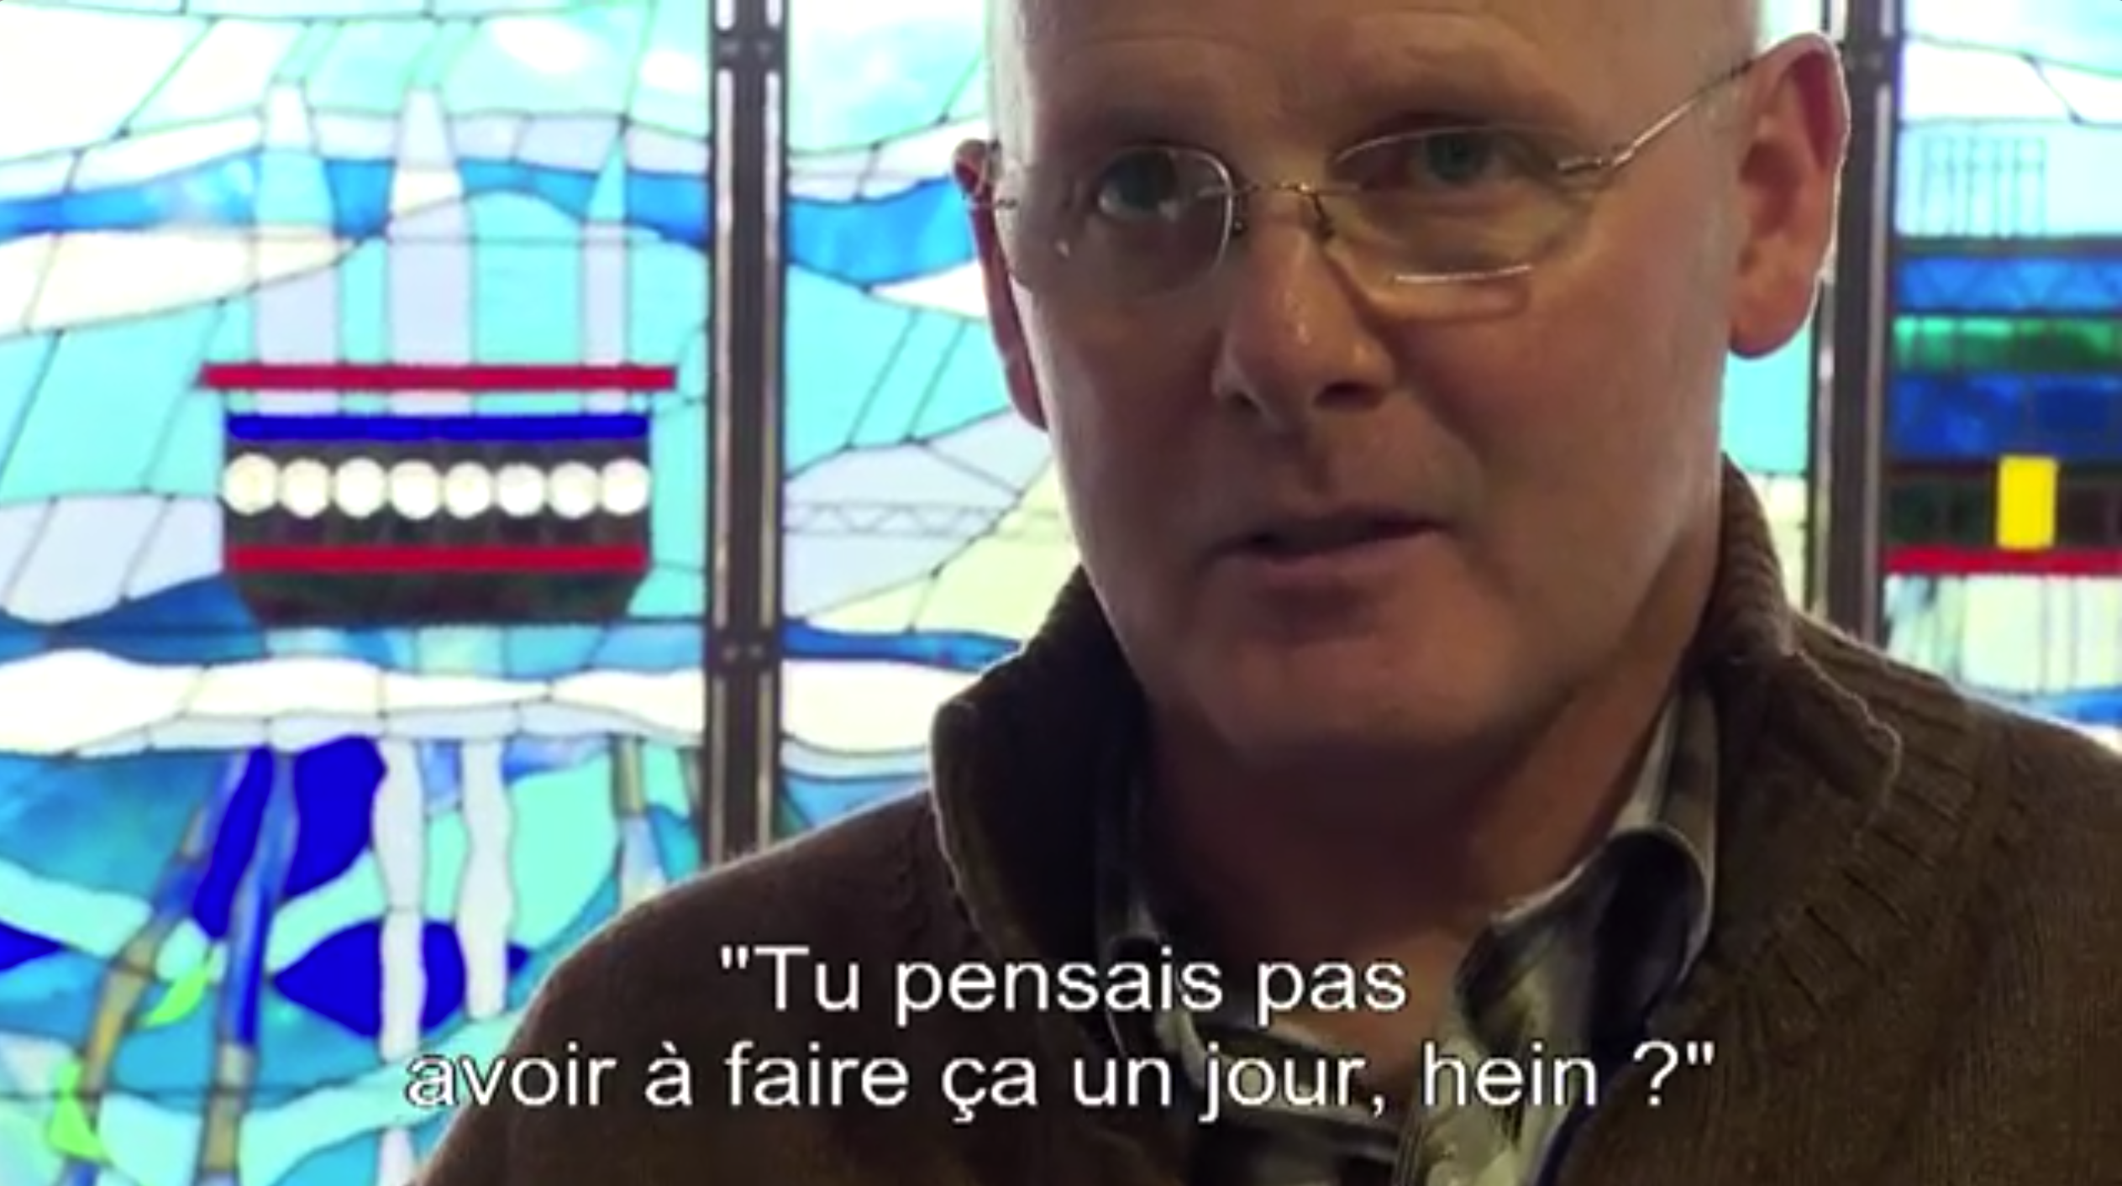
Video of interview with Bill Cardno – Elgin site manager

Slide 6
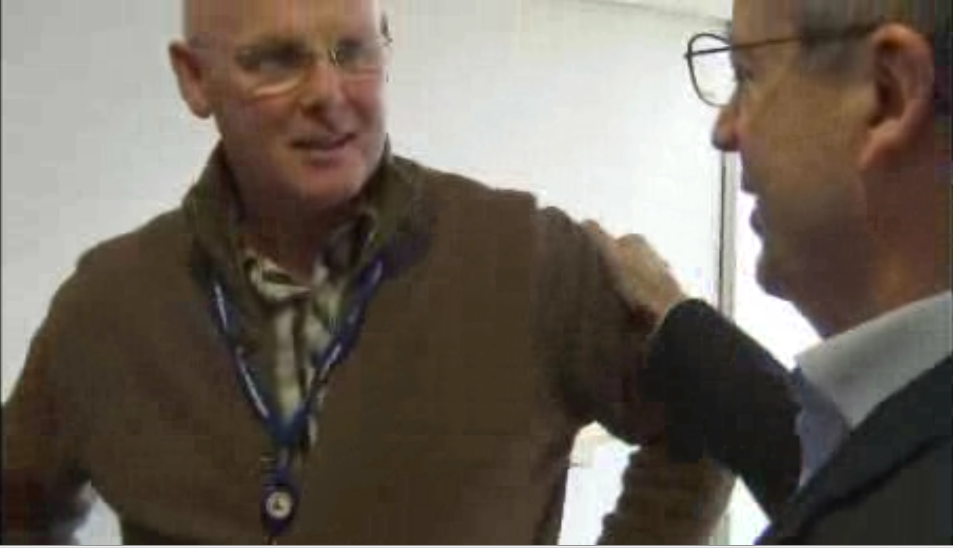
Video of Y-L Darricarrère visit

Slide 7
Total Safety Value
Safety has been a priority for Total for many years.
Since January 2016, safety has been ranked as a value.
Consequences on our operations: actions that tend to preserve and improve safety are always put forward.
No criticism or blame if you react on the side of safety, even if it means shutting down an important operation.
Total wants to be the leader in responsible energy.
If you do not share this safety value, you should not be working for the Group.

Slide 8

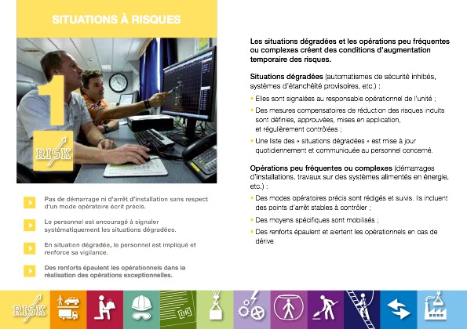
Important tools for the safety value
The “Stop Card”, an exchange and discussion tool to reduce risk taking,
The 12 golden rules, essential rules to follow and put forward to work in complete safety,
Feedback
Anomaly reporting (abnormal situations),
And many others…

