Slide 1
The HSEQ Charter
Safety Training for New Recruits
Module TCG 1.3

Slide 2
MODULE OBJECTIVES
At the end of this module:
You should be able to make the link between the Group's safety value and the HSEQ charter.
You will know the HSEQ charter and be able to explain its principles.

Slide 3
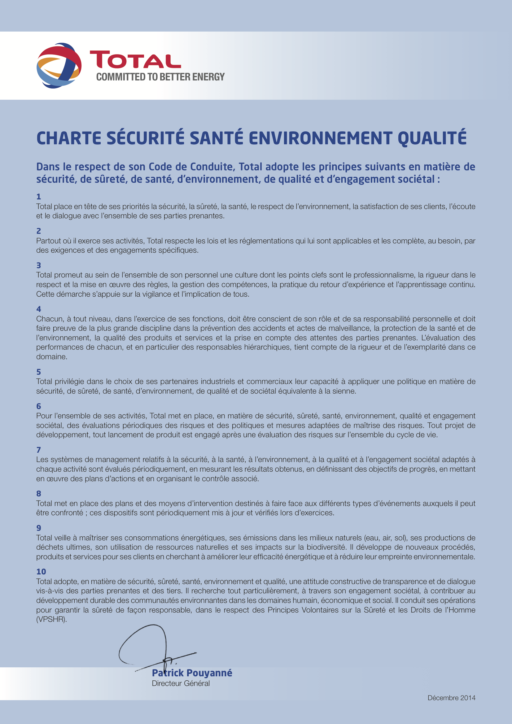
Health, Safety, Environment and Quality charter
Article 1
“Total places safety, security, health, respect for the environment, customer satisfaction, listening and dialog with all of its stakeholders at the top of its priorities.”

Slide 4
Identify the elements of the Group's HSE policy
HSE commitment
General Management
Adherence to legislation
HSE culture
HSE management
of partners
Risk assessment
HSE system
management
Crisis management
Recognition of employee
HSE performance
Acceptance by third parties
Sustainable development
Notes:
Animated slide
5 mins:
Present the workshop objective: to identify the basic elements of the Group's HSE policy.
Split the group into teams (maximum 5 or 6 teams), spreading out participants from each branch.
Distribute: Paperboard + large Post-its + marker pens + Group HSE charter per team
10 mins approximately:
Step 1: Ask the teams to list 10 key topics from the TOTAL HSE charter and link them with the article number.
Not more than 4 words per topic.
One topic per Post-It (write everything in large letters using the markers)
8 mins approximately:
Go around the teams, using a rapporteur/team to present the answers
Expected answers: Commitment of General Management, HSE culture, Recognition of employee HSE performance, HSE management of partners, HSE management system, Crisis management, Risk assessment, Adherence to legislation, Acceptance by the third parties, Sustainable development.
1 min
Click to display the correct answers

Slide 5
Identify the elements of the Group's HSE policy
HSE commitment
General Management
HSE culture
Increase the commitment
of management and employees
Recognition of employee
HSE performance
HSE management
of partners
Risk assessment
Implement HSE methods
and practices
HSE system
management
Crisis management
Improve transparency and communication with third parties
Adherence to legislation
Acceptance by third parties
Sustainable development
Notes:
Animated slide
5 mins:
Step 2: Ask the teams to highlight the Total charter's 3 major focal points.
This involves:
Grouping the 10 topics (Post-its) by focal point on the paperboard
Naming each focal point by starting with an action verb (marker pen + paperboard).
Type of answer expected:
Focus 1: Boost management's commitment
Focus 2: Develop HSE methods and practices
Focus 3: Improve transparency and communication with third parties
1 min:
Click to display the correct answers

