Slide 1
Our Major H3SE Risks
Safety Training for New Recruits
Module TCG 2.1

Slide 2
Module objectives
At the end of this module:
You will be able to explain what the H3SE is
You will be aware of the major risk areas specific to Total
Will know how to measure our H3SE results and, in particular, explain what the TRIR is and what its purpose is.

Slide 3
H3SE - The domains
Hygiene/Health
Societal
H3SE
Safety
Environment
Security
Other domains can be added here
  Sometimes Quality ➔HSEQ or H3SEQ

Slide 4


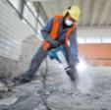
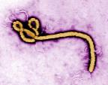
HYGIENE-HEALTH
Chemical risks
Physical/ergonomic risks
Biological risks
Psychosocial risks
Notes:
Chemical risks:
Certain substances cause serious, even fatal, illnesses
The risk may be present on the site or off the site via emissions (health impact) or product sales
The risk can be delayed: it can occur 5 to 30 years after exposure
Physical/ergonomic risks: Certain repetitive work, noise and radiations also cause long-term illnesses
Biological risks:
Our lifestyle exposes us to pandemics
We are established in tropical countries
Specific industrial risks (legionella)
Biotechnologies

Slide 5
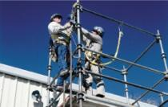
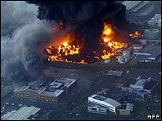
SAFETY
Workstation safety
  movement, falls, tools, handling
Safety related to the operation of plants and processes
  Fires, explosions, toxic leaks, natural risks
Notes:
Workstation safety:
Variable but generally limited severity
A widely developed prevention
A measurable outcome
Safety related to the operation of plants and processes
The consequences can be catastrophic
We are not protected individually
The associated cost is high

Slide 6



SECURITY
Security: intentional malicious acts
  Security primarily concerns the protection of people, assets and information
  Against a danger or malicious threat
Vocabulary
  Safety: accidental events (not intentional)
  Security: intentional malicious acts
  Please note: in English
    Sécurité ➔ safety / Sûreté ➔ security
Notes:
Danger or malicious threat:
Common crime, hold-up, theft, hacking
Societal/political disturbances
Terrorism
Sabotage
Espionage
Fraud, cybercrime

Slide 7
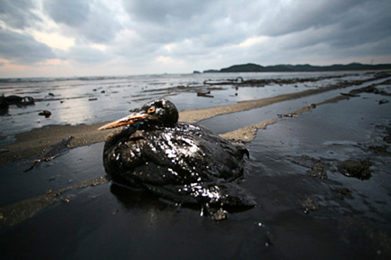

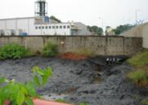
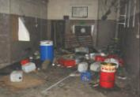
Environment
Environmental risk related to the operation of facilities and processes (technology)
Air/water emissions
Ground pollution
Waste
Climate change
Notes:
Environmental risk related to the operation of plants and processes
Oil slicks, etc.
Air/water emissions
Developed countries:
Industrialists have made great strides, either willingly
or under regulatory pressure
Industrial pollution can be felt locally (disturbances more than pollution)
The risk of accidental pollution is always present
Developing countries:
Industrial pollution is still a real problem
Ground pollution
The problem is compounded when it is transmitted through the water
The potential economic impact is very significant
Waste
It is difficult to find waste treatment schemes in certain countries
Climate change
Greenhouse gases have been an issue over the last few decades
Planetary impact is very popularized through the media
Important aspect for the Group
50 Mt CO₂ eq legacy (≈1/1000th of world emissions)
600 Mt with the impact of our oil products (≈ 1/100th of world emissions)

Slide 8
Societal
Take into account the impact on civil society
and local communities.
Developed countries
  Risk aversion: devastating effects of industrial accidents
  Bad image of the oil industry
  Power of associations/NGOs
Developing countries
  Wealth gap between our projects and the communities that accommodate them
  Wealth of oil not redistributed with communities
  An industry rather weak in mobilizing the workforce
  Many expatriates

Slide 9
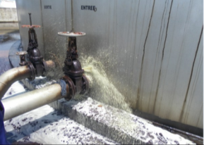
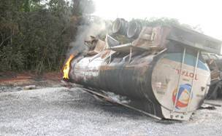
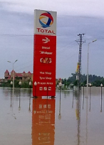
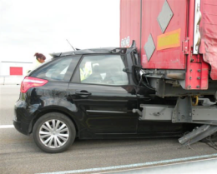
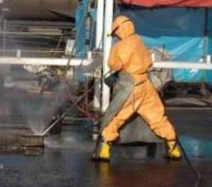
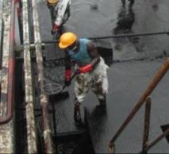
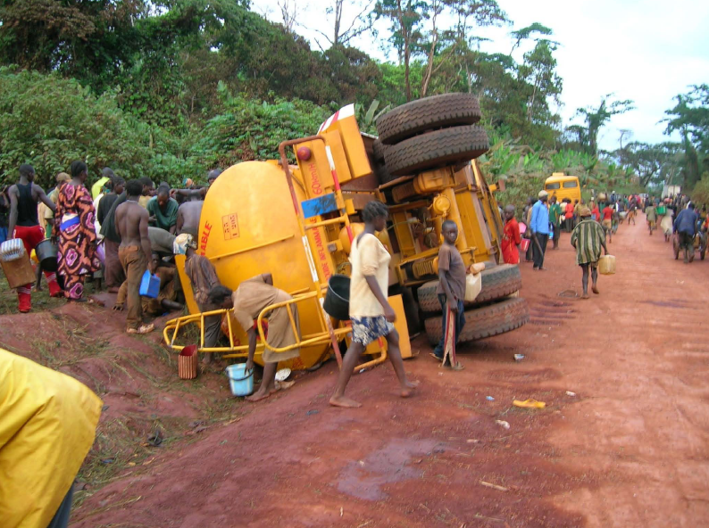
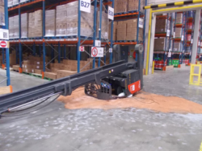
Fires, explosions
Leaks
Transport
Natural risks
Hold-ups
Lifting
Light vehicles
High-risk work
Pollutants
Plundering
Forklift trucks

Slide 10
CONTROLLING OUR H3SE RISKS: AN INDISPUTABLE ADVANTAGE
  Working on these risks creates value, which plays a part in achieving excellence in quality, image and connection with stakeholders.
  Not only for compliance with regulations. But these are actions that the Group benefits from every day.
  Moreover, this plays a part in improving the practices for the rest of the industry as well (in particular our partners and close competitors).
  Controlling the H3SE risks influences the economic performance of the company and its outcomes (award of new contracts etc.)

Slide 11
SOME INDICATORS OF H3SE PERFORMANCE
TRIR
Total Recordable Injury Rate.
This is an incident frequency rate, calculated by millions of hours worked, as follows:
Number of accidents with injury _________________________
millions of hours worked
HiPo
High Potential Incident
This is the number of events reported that could have had major or catastrophic consequences. The statistics are taken from reports. Each HiPo is followed up with an action plan.
These indicators are followed up by all sectors throughout the Group. They are the same across the entire oil industry.
The Group counts contracted companies in its own statistics (specificity of the oil business and other very large companies)

Slide 12
TRIR CALCULATION EXERCISE
Exercise 1 – Calculate your TRIR
Over the span of your career, supposing that you sustain a sprain during this time.
A career lasts on average 40 years, at a rate of 40 hours worked per week, and 50 weeks per annum.
Exercise 2 – Calculate the TRIR of a company
A company of 1000 employees counts 1 accident over one year (40 hours worked per week, and 50 weeks per annum).
Exercise 3
A company of 100,000 employees counts 50 accidents over one year (40 hours worked per week, and 50 weeks per annum).
The formula to calculate the TRIR:
Number of accidents
_________________________
Millions of hours worked

Slide 13
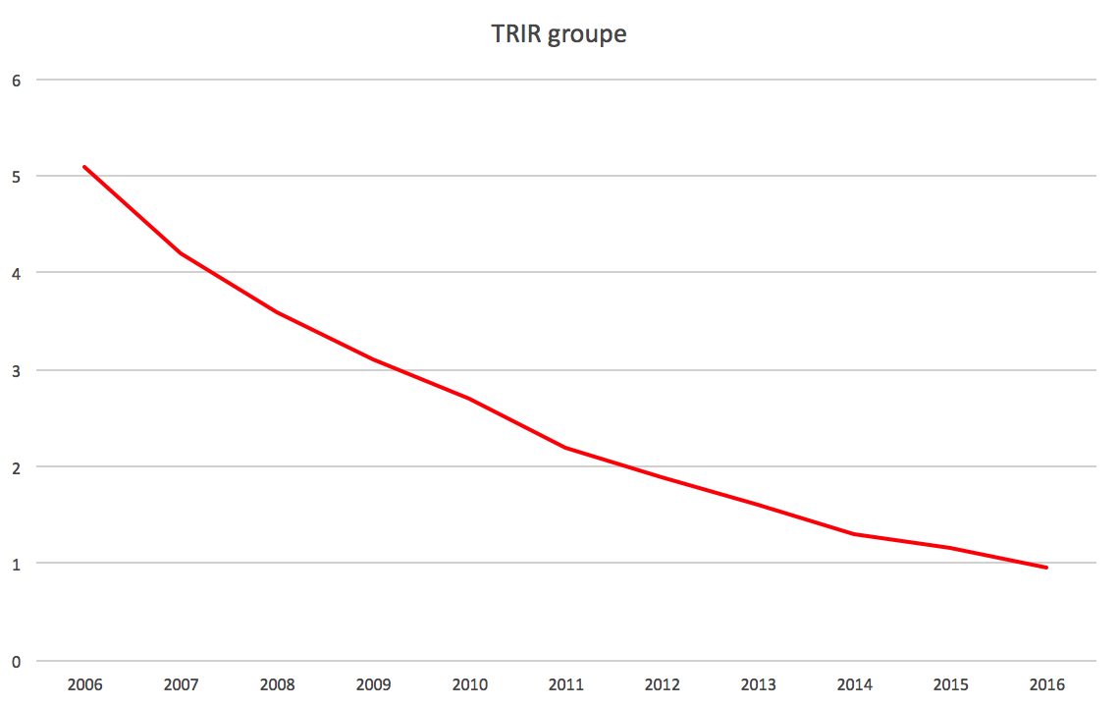
TRIR for the Total Group
TRIR
TRIR drop = Less accidents

