Slide 1
Technological risks, Major Incidents
Safety Training for New Recruits
Module TCG 2.2

Slide 2
Module objectives
At the end of this module, you:
Will know what the technological risks are.
Will know the main accidentology of the Total Group and oil sector.
Will have understood what lessons the industry (and the Total Group) drew from major incidents.
Will have understood that technological risk and workstation risk are not directly linked.

Slide 3
Possible consequences:
Incident | Consequences?
Oil slick
A car leaves the road and flips over 4 times
A person falls off a scaffold
Gas pipeline explosion
Fire in a storage tank
Fall down a staircase

Slide 4
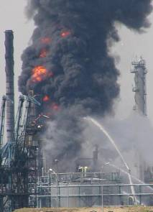
TECHNOLOGICAL RISK/WORKSTATION SAFETY
The difference: severity and probability
Technological risk:
  Serious (disastrous consequences)
  Low probability (rare)
Workstation safety/risk
  Moderate severity
  Frequent, possible,…
Probability
Severity

Slide 5
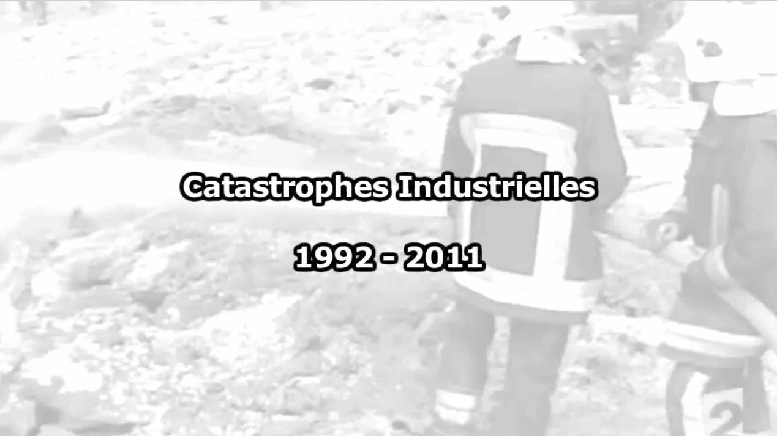
FILM: Industrial catastrophes
(related to technological risks)

Slide 6
Dangerous phenomena
THERMAL
FLOWS
OVERPRESSURE
POLLUTION
TOXICITY

Slide 7
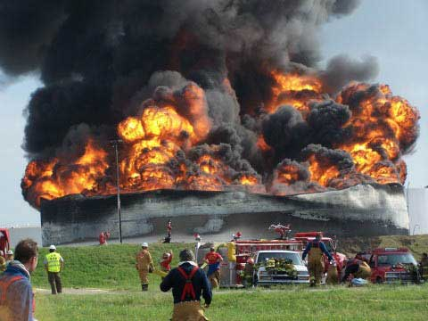
Dangerous phenomena
POOL FIRE
Tank fire
Leaks from flammable materials and ignition sources.
Ignition of a tank

Slide 8
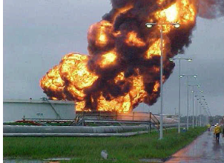
Dangerous phenomena
BOIL-OVER
Hydrocarbon tank ignition
Decreased level in the tank
Explosive steaming of water at the bottom of the tank

Slide 9
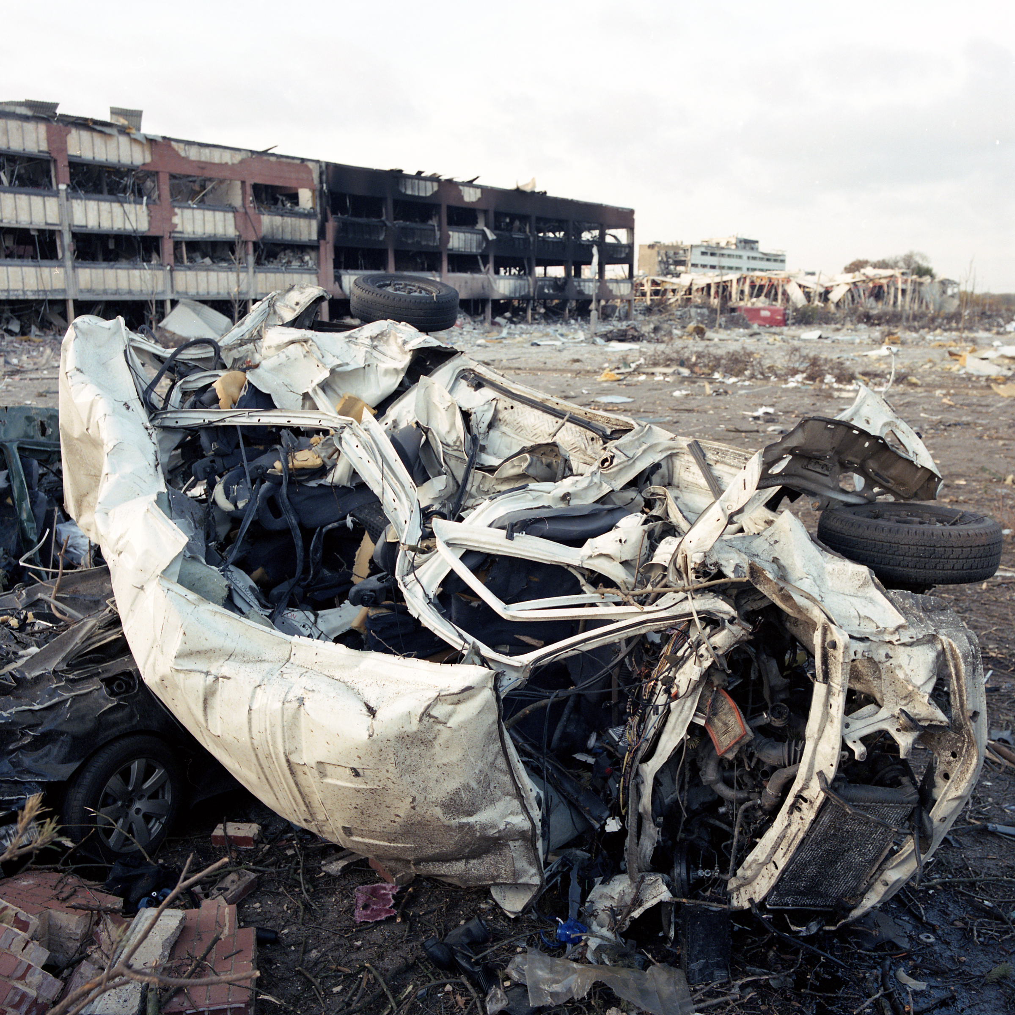
Dangerous phenomena
UVCE
(Unconfined Vapor Cloud Explosion)
Leaks from flammable materials
Formation of a flammable gas cloud
Ignition and explosion of a gas cloud

Slide 10
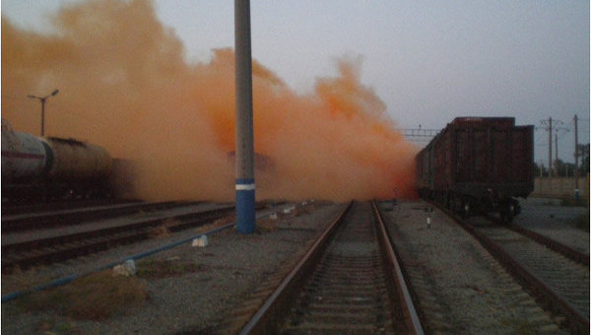
Dangerous phenomena
DISPERSION/SPILLAGE
Liquid spillage
Gas leakage or vaporization
Formation of a gas cloud

Slide 11
Dangerous phenomena
Pool fires,
tank and basin fires
Ignited jet
Boil over
BLEVE
UVCE
Bursting of a pressure drum
THERMAL
FLOWS
OVERPRESSURE
POLLUTION
Dispersion
Spillage
TOXICITY

Slide 12
Dangerous phenomena
THERMAL
FLOWS
tank and basin
BUNCEFIELD
FEYZIN
BLEVE
OVERPRESSURE
LA MEDE
UVCE
TEXAS-CITY
UVCE
A Z F
Explosion
TOXICITY
POLLUTION
SEVESO
BUNCEFIELD
MACONDO
Dispersion, spillage

Slide 13
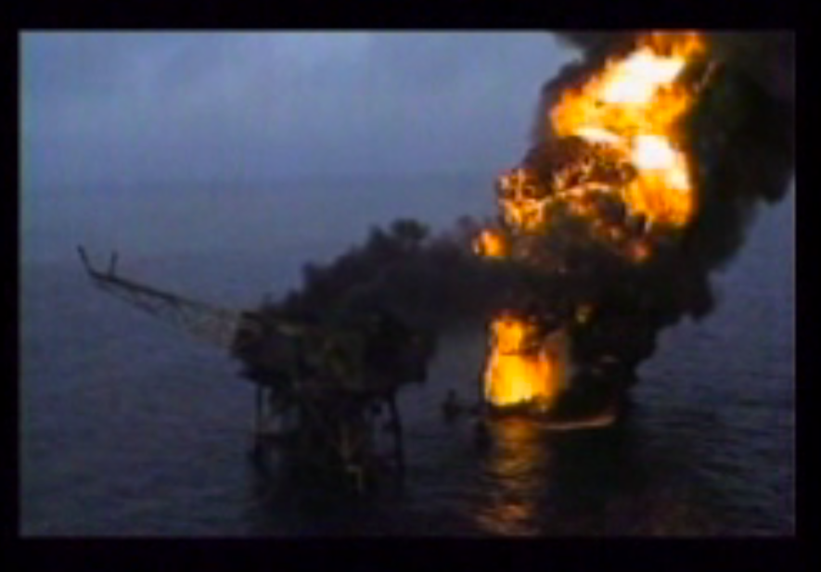
FILM on the Piper Alpha catastrophe

Slide 14

Lessons following the accidents
SEVESO
1976
BHOPAL
1984
more than 3500 deaths
Piper Alpha 1988
168 deaths
FEYZIN 1966
18 deaths/84 casualties
LA MEDE
1992
6 deaths
Erika
1999
A Z F
2001
30 deaths
BUNCEFIELD 2005
Damage > 1G€
MACONDO
2005
Damage > 1G€
The 1960s
1990
Today
Legislation
France/
Europe
Law on classified facilities
1976
European directive
Seveso I,1982
Seveso II
1996
Seveso III 2015
International regulations

Slide 15
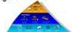
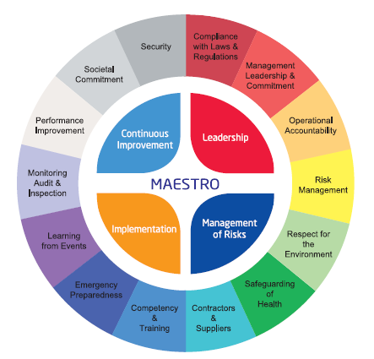
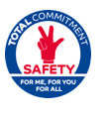
Lessons following the accidents
SEVESO
1976
BHOPAL
1984
more than 3500 deaths
Piper Alpha 1988
168 deaths
FEYZIN 1966
18 deaths/84 casualties
LA MEDE
1992
6 deaths
Erika
1999
A Z F
2001
30 deaths
BUNCEFIELD 2005
Damage > 1G€
MACONDO
2005
Damage > 1G€
The 1960s
1990
Today
Legislation
France/
Europe
Law on classified facilities
1976
European directive
Seveso I,1982
Seveso II
1996
Seveso III 2015
International regulations
Safety regulations for engineering, design
An HSE management system
Campaigns on HSE behavior
Feedback and regulation development

Slide 16
Focus on the HIPOs for major incidents
The high-potential incidents in terms of consequences (HIPO = HIgh POtential) are precursors for technological incidents.
The TRIR measures the incident frequency rate.
The TRIR does not anticipate fatalities and the major incidents.

