Slide 1
Safety: Deaths/accidents
Safety Training for New Recruits
Module TCG 2.3

Slide 2
Module objectives
At the end of this module, you:
Will understand that deaths are not inevitable, that the norm is that there is never death in the Group and that this is invaluable for any individual in anything they do either close to or away from Total's activity.
Will understand the concepts of TRIR, HIPO and fatal incident, and their connections.

Slide 3
Group objective
0 deaths

Slide 4
Objective: 0 deaths

Slide 5
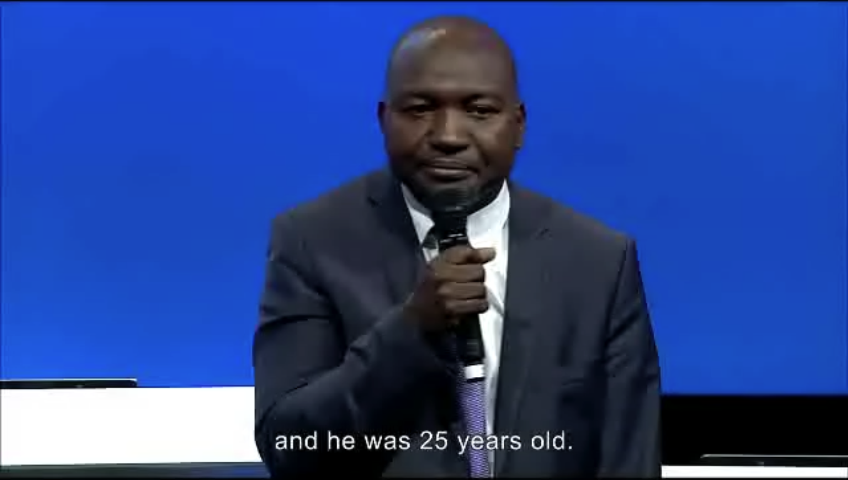
FILM: Testimony of a general manager who lost an employee

Slide 6
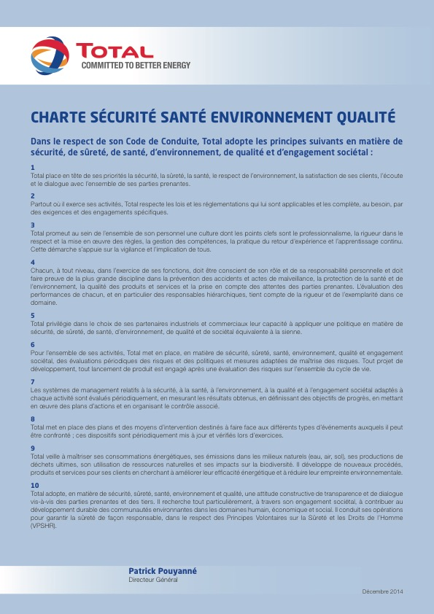
Objective: 0 deaths

Slide 7
Objective: 0 deaths
The purpose is clear: 0 deaths in the Group.
No-one should die while working at TOTAL, or for TOTAL (contracted)

Slide 8
What about you?
In your daily life (outside of work), how do you prevent accidents?
Can you describe a situation in which you came very close to death (or with very serious consequences)?
What do you do at home to ensure these kinds of accidents do not happen?
How does this tie in with the framework of your mission at Total?

Slide 9
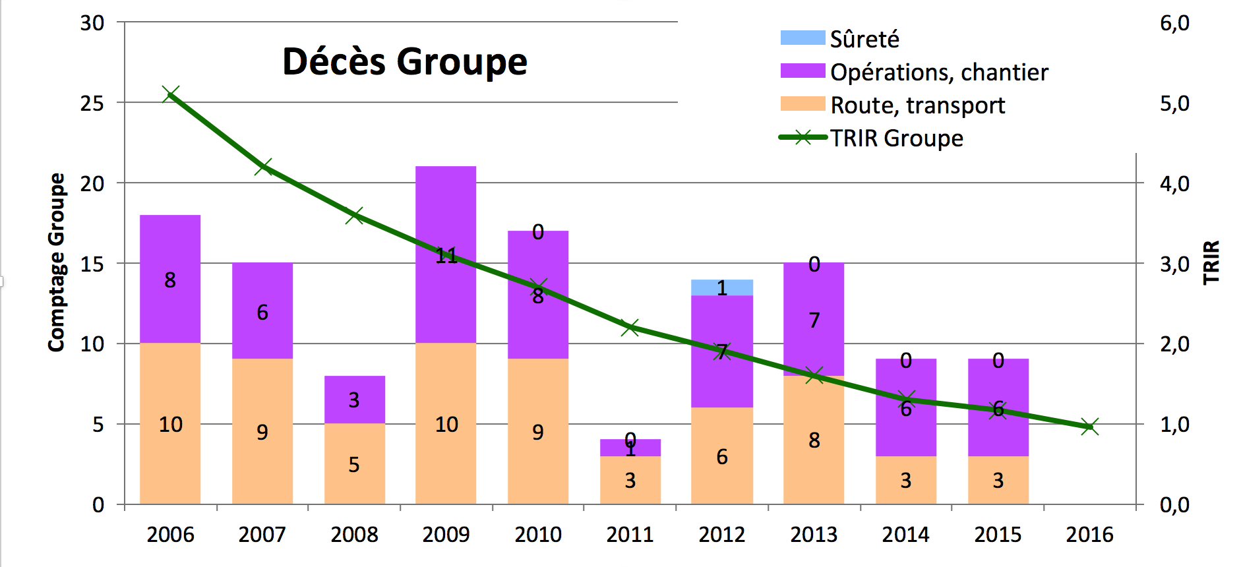
TRIR vs deaths

Slide 10
Prevention of fatal accidents by:
Following regulations and procedures
These procedures and regulations must exist, be known and applied with the utmost rigor.
Regular audits on the ground to check the application of and adherence to regulations and to appreciate the real risk (hazardous situations).
Your own behavior as a person and vigilance towards others:
Broader perspective on your own activities.
Risk analysis.
Concern for the lives of the others.
A strong bond with contracted personnel.
Although zero risk does not exist,
all fatal accidents can be avoided.
Notes:
The key is stringent adherence to the regulations and safety procedures as well as systematic analysis and reporting of incidents and near misses, taking the human factor into account.

