Slide 1
Psychosocial Risks
Safety Training for New Recruits
Module TCG 2.5b

Slide 2
Module objectives
At the end of this module, you:
Will know the behavior to adopt in order to avoid/prevent psychosocial risks.

Slide 3
Specific situations
When he arrives one morning, Henri discovers a very tired colleague crying in front of his computer.
A colleague of Simone's has, for several weeks, been very aggressive in meetings and with his team, whereas he usually remains calm and constructive.
A new recruit seems to be in a very marked state of anxiety. On the third week, he complains that the workload is too much and he is unable to do it…
What do these situations have in common?

Slide 4
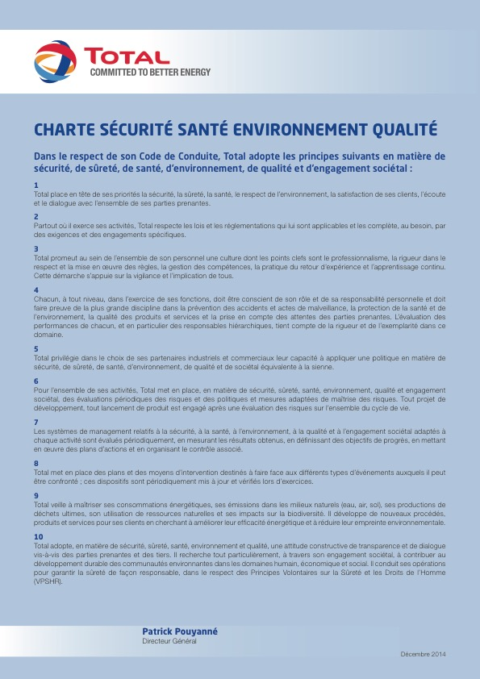
An important issue for the Total Group
Agreement of 20th January 2016 on the prevention of RPS to improve conditions in the workplace (in France).
“Together, we can prevent RPS” kit
Refer to the intranet.

Slide 5
RPS

Slide 6
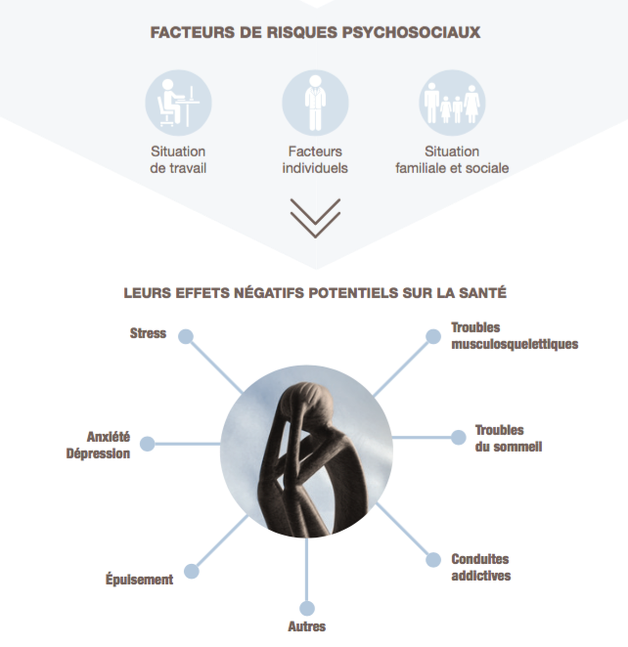
Psychosocial risk factors

Slide 7
Behavior as a colleague
Behave well
Alert
Guide, if needed

Slide 8
Behavior as a colleague
Behave well:
Be attentive to colleagues, particularly those displaying any changes: what appears different to their usual behaviors and what has unfolded in the meantime?
In relation to the ethics code: listen, respect, etc.
Alert:
Report to your line manager or HR.
Guide, if needed, towards a contact who is experienced with and has an awareness of RPS:
Your chain of command
Human Resources
The (occupational) doctor, social workers
Staff representatives

Slide 9
Specific situations
When he arrives one morning, Henri discovers a very tired colleague crying in front of his computer.
A colleague of Simone's has, for several weeks, been very aggressive in meetings and with his team, whereas he usually remains calm and constructive.
A new recruit seems to be in a very marked state of anxiety. On the third week, he complains that the workload is too much and he is unable to do it…
Which behavior to adopt?

