Slide 1
One MAESTRO and HSE Organization
Safety Training for New Recruits
Module TCG 3.1

Slide 2
Module objectives
At the end of this module, you:
will understand what MAESTRO is and you will be able to quote it key contents.
will know the Group's HSE responsibilities, including yours.

Slide 3
Actual situation: general manager of 3 risk centers
“After several years of reflection, John decided to create 3 centers for high-adrenalin sports”: Two parachuting centers in two different countries and a racing circuit in one of the two.
The project is advanced since the 3 centers are ready, even minimally operational, with about thirty specialized instructors, mechanics and staff recruited. Almost nine pieces of equipment (cars, planes, etc.) are operational.
Conscious of the dangers of these activities, John really wishes to avoid any accidents or incidents and is very strict on the fact that risks be effectively controlled, whatever the site.
He feels he is the only one responsible for ensuring the safety of the entire project. And this morning, he is a little anxious, as he discovered some surprising practices when he examined the sites last week. Working remotely, he cannot be the only person responsible."
What sort of risk control measures do you think he could implement to give him more peace of mind?

Slide 4
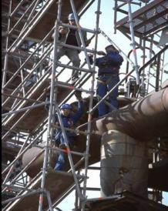
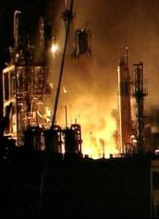



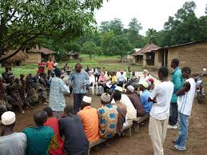
One MAESTRO
Management And Expectation Standards Towards Robust Operations
Workstation safety
Major risks
Security
Environment
Hygiene
Societal
A joint approach for managing risks

Slide 5

One MAESTRO: a Group HSE framework
A framework to control and manage the risks for the whole Group.
Principles, requirements to be developed by Branches, subsidiaries to sites.
Arising from a Branch HSEQ policy, the regulations, responsibilities, operating processes, mandatory requirements, etc.
The implementation of ONE MAESTRO on sites and subsidiaries is checked regularly through an audit (MAESTRO AUDIT).

Slide 6
The MAESTRO principles
Principle 01 - Management, Leadership, Communication and Commitment
Principle 02 – Respect for laws, regulations and Group requirements
Principle 03 – Management of risks, design and construction
Principle 04 – Reliability and effectiveness of operations
Principle 05 – Contractors and suppliers
Principle 06 – Skills and training
Principle 07 – Emergency: preparation and response.
Principle 08 - Incident management and exchange of information
Principle 09 - Monitoring, audit and control
Principle 10 – Performance improvement

Slide 7
The MAESTRO principles and requirements
Principle 04 – Reliability and effectiveness of operations
“For all activities, the hazards to which people, the environment and properties are exposed are systematically identified, the associated risks assessed and the measures enabling them to be reduced are determined and implemented.”
CR EP HSE 001: Using a needs assessment, Management must implement the regulations, procedures and work permit system to use to control the activities. These activities comprise, among others, land/maritime/air transport, lifting and entry into confined spaces. These regulations, procedures and work permit system must be reviewed by the relevant personnel as often as necessary to ensure their adequacy with the risks assessed.

Slide 8
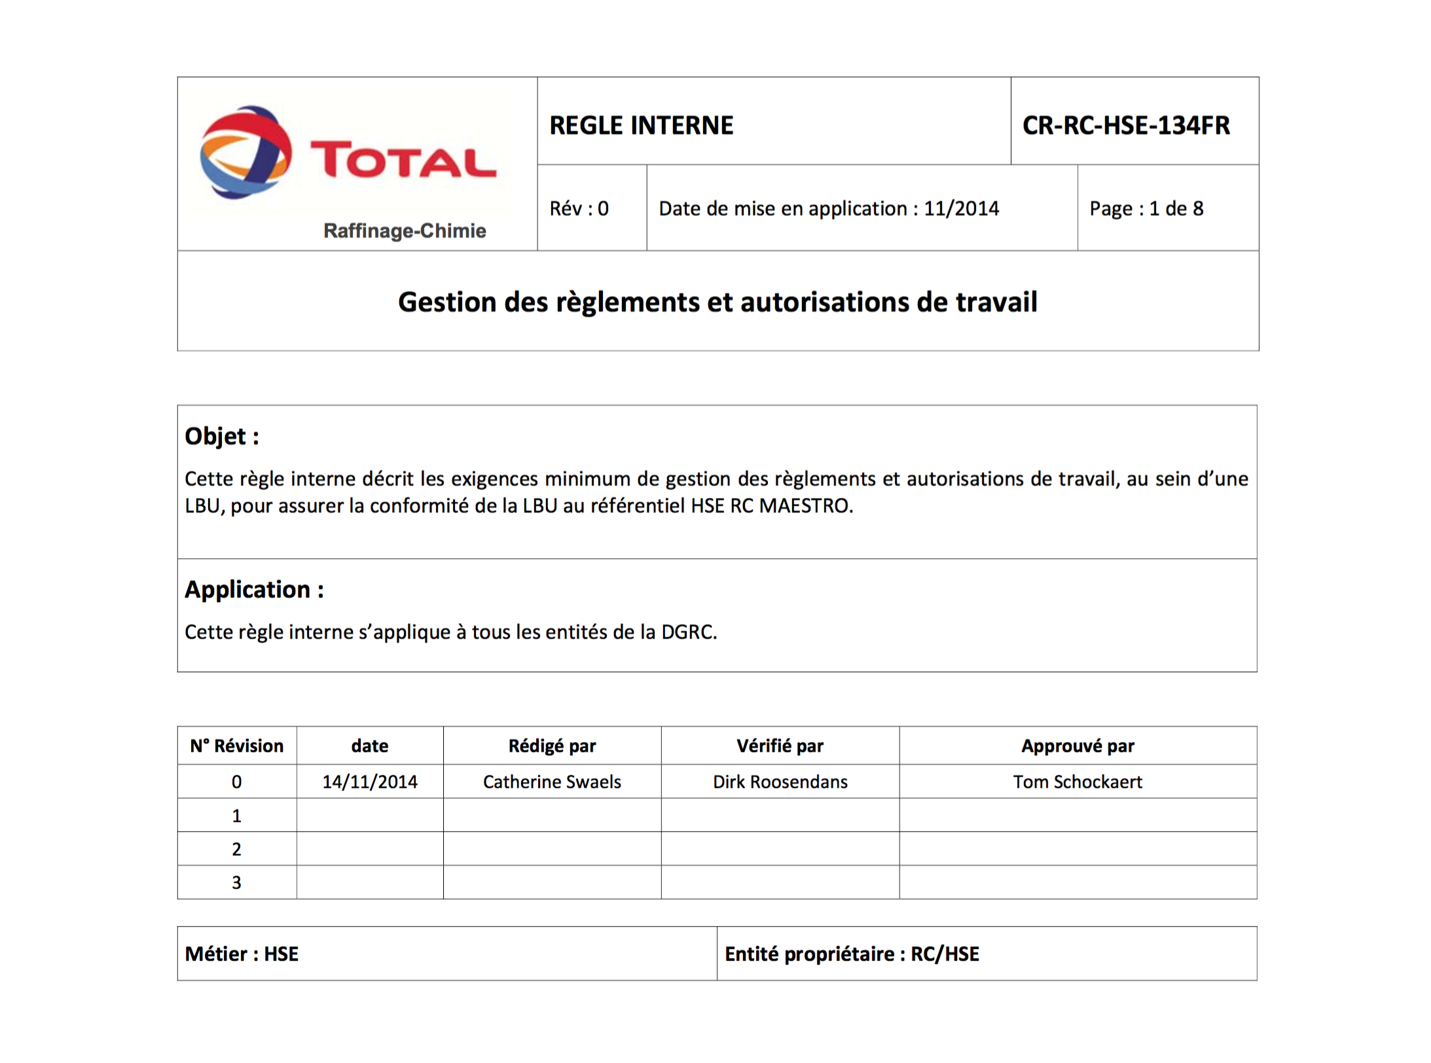
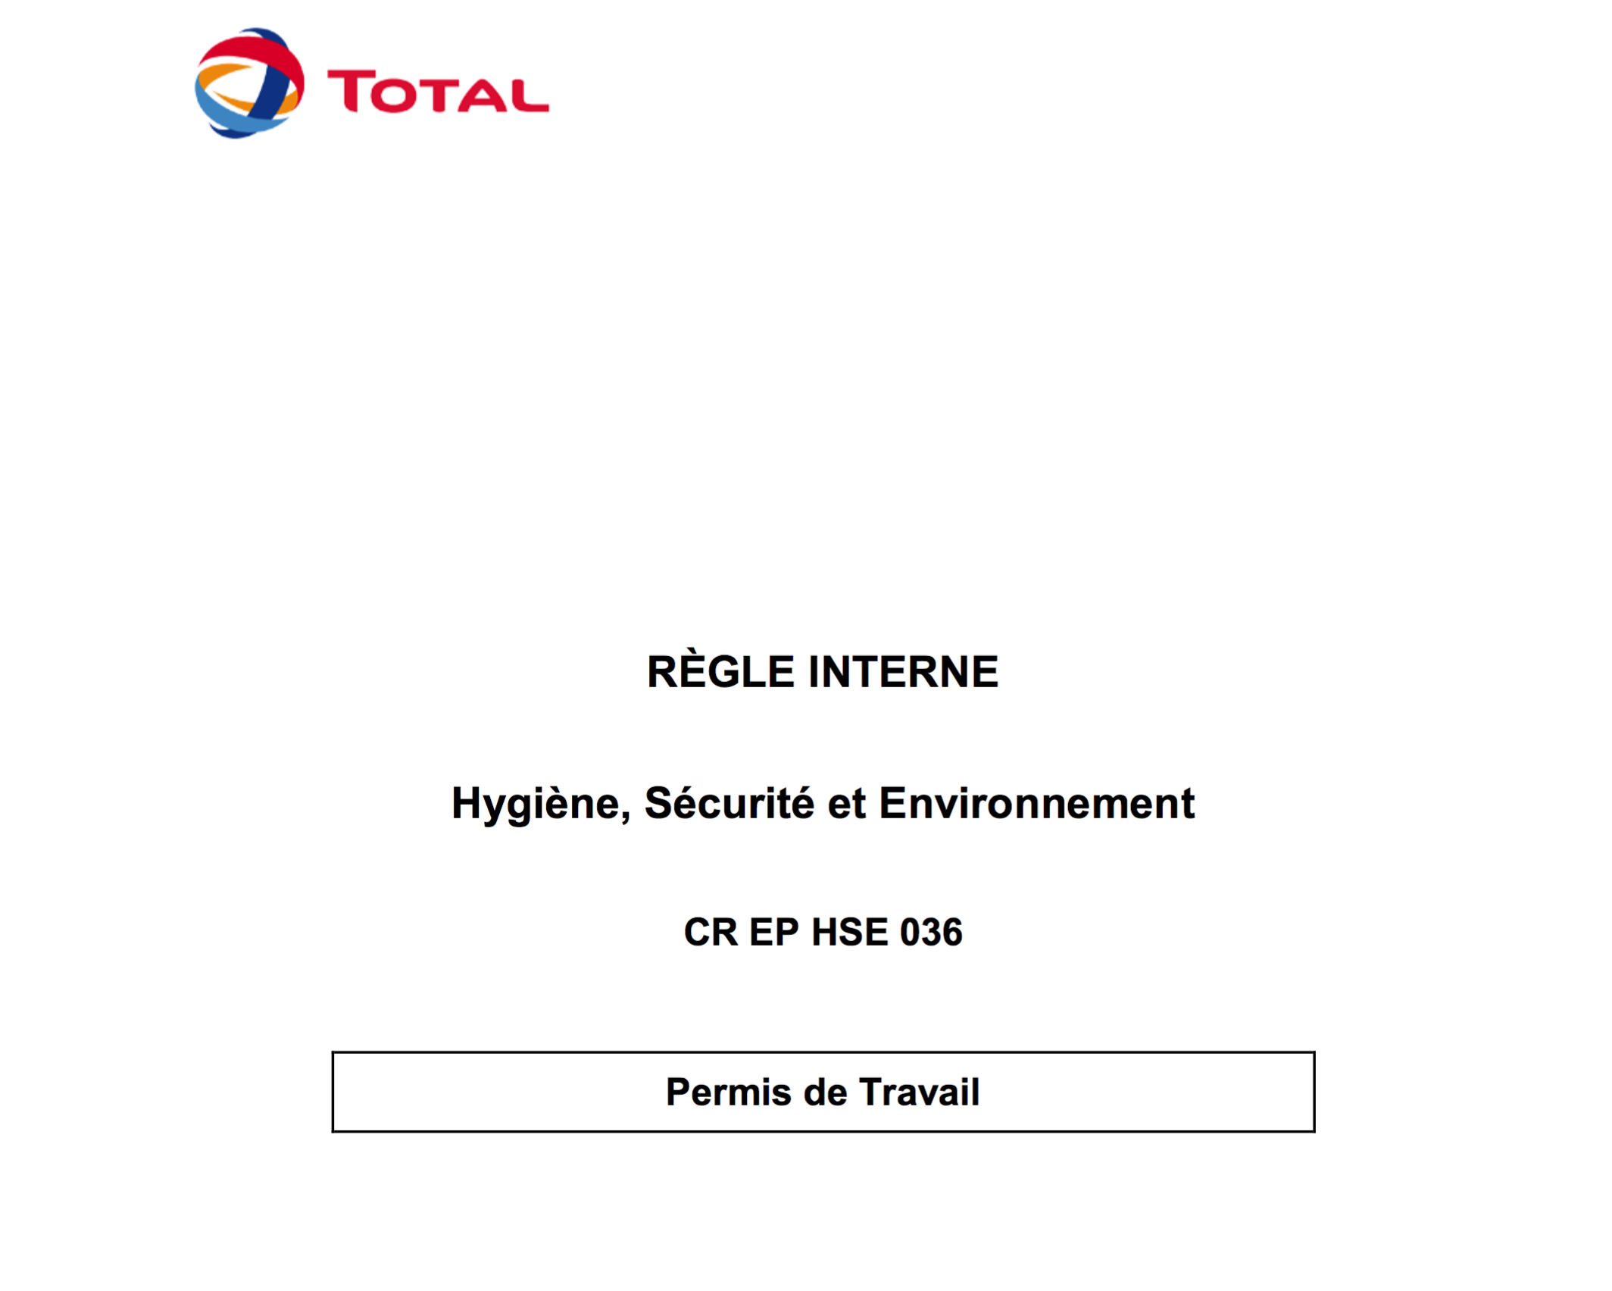
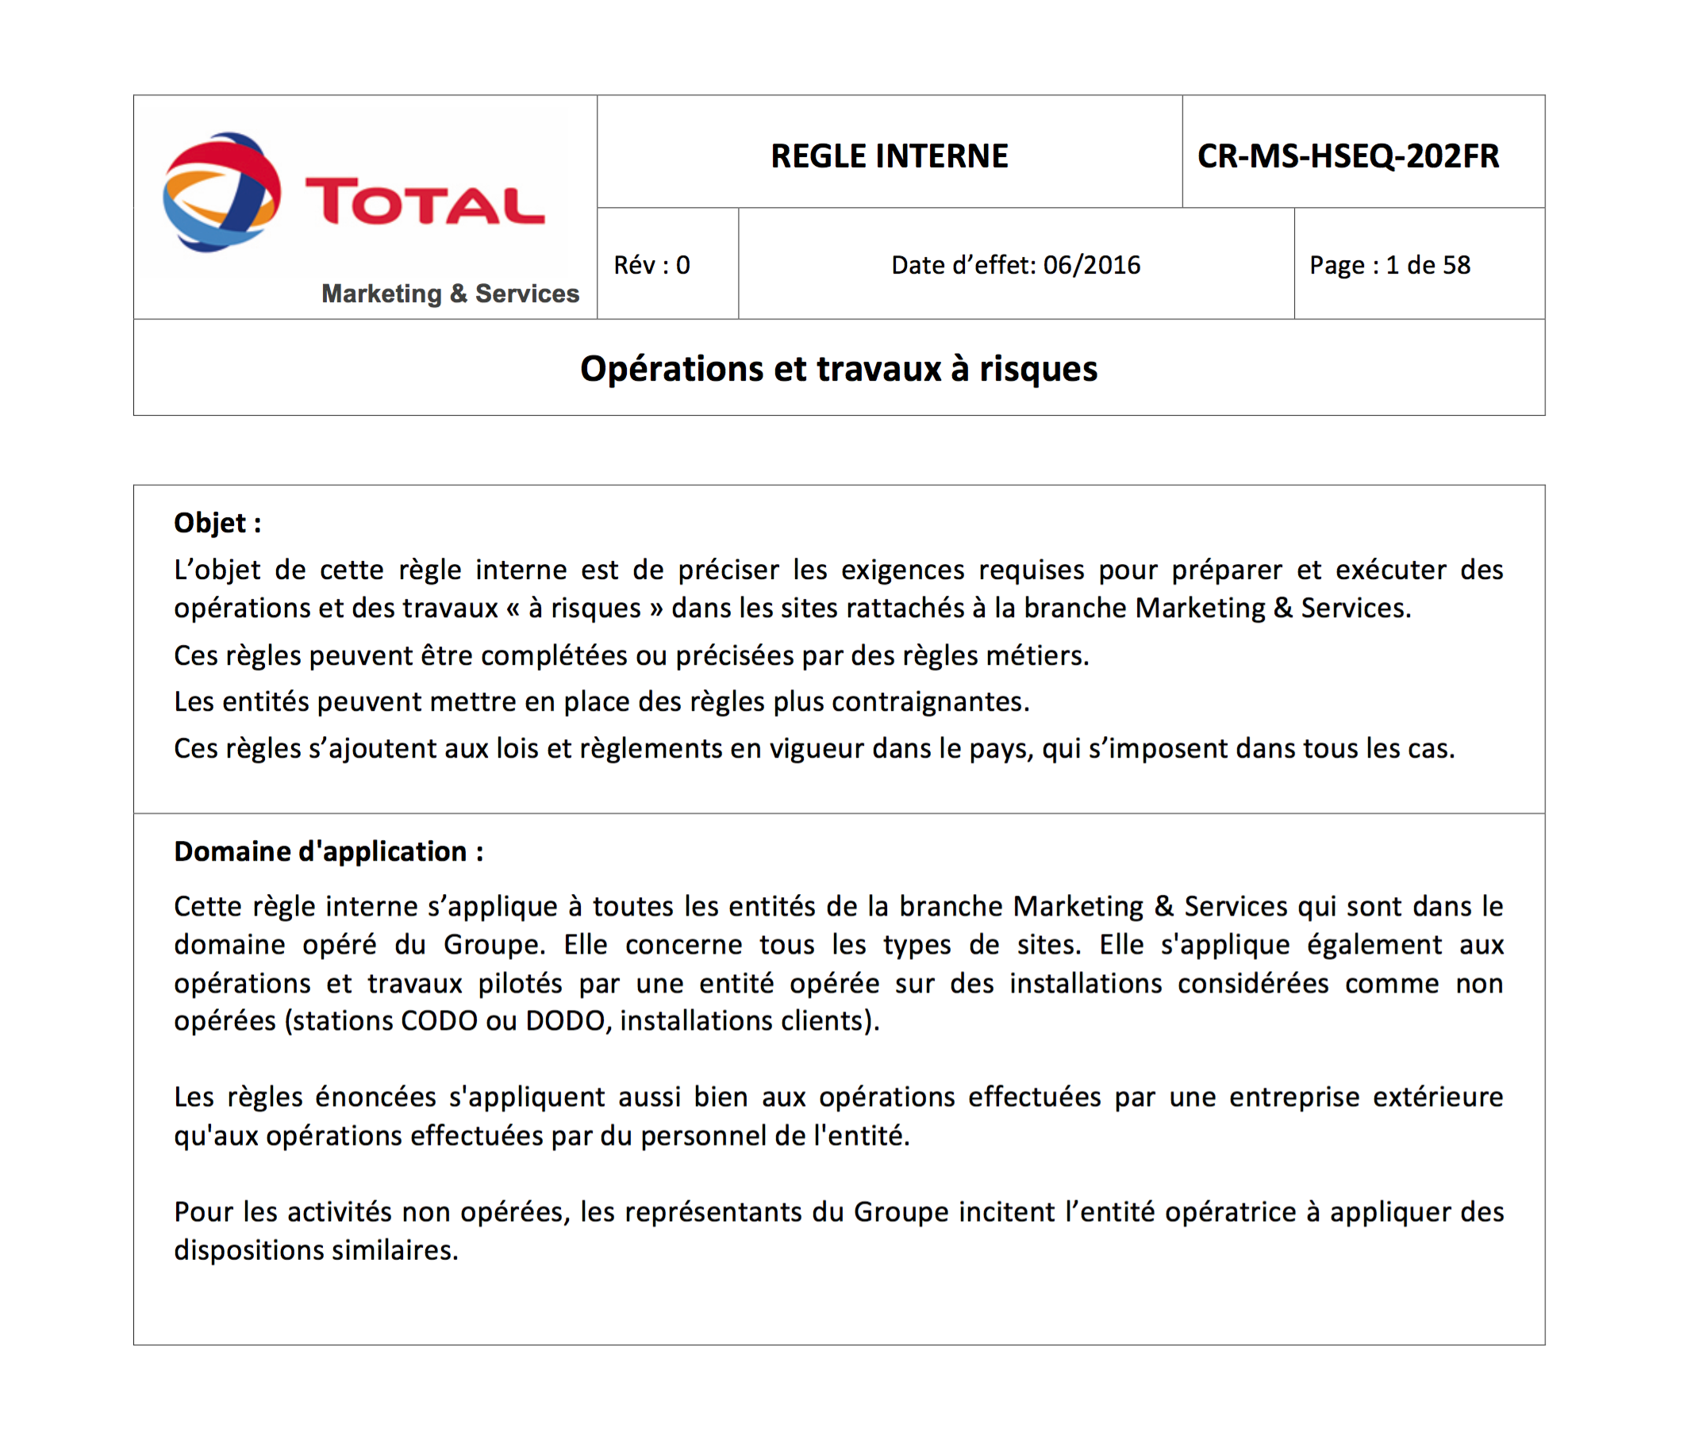
The MAESTRO principles and requirements

Slide 9

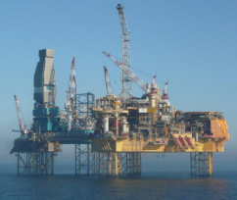
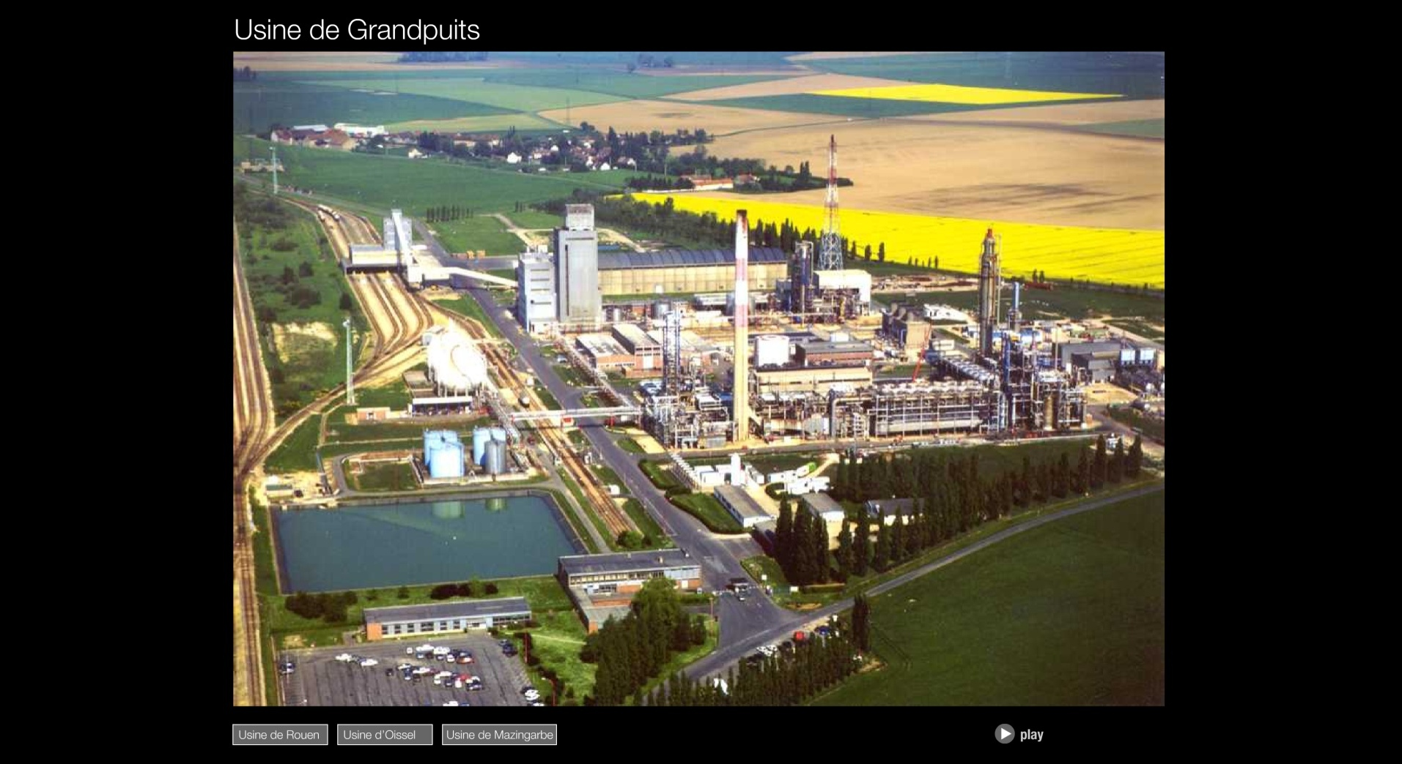
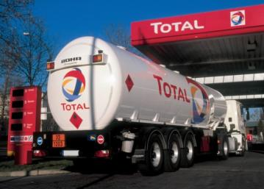
HSE technical standards
Group level
Branch level:
EP
MS
RC
GRP
Site/subsidiary level

Slide 10

HSE technical standards: a comprehensive set of documents for Group to site/subsidiary level
Group level
Branch level:
EP
MS
RC
GRP
Directives
Company regulations
Guide and manuals
Site/subsidiary policy
Regulations
Procedures
Site/subsidiary level

Slide 11

A shared HSE culture
Anomaly reporting
Golden Rules
Feedback
STOP card
Audits
Event reporting

Slide 12
ACTUAL SITUATION: THE HSE ROLE OF…
John
The center manager
The instructor
Each parachutist
An HSE technician, if John recruited one

Slide 13
HSE responsibilities in the Total Group
The general manager = the HSE manager
CEO (Mr Pouyanné)
The Branch manager
The Site/subsidiary manager The Site/subsidiary HSE operational manager
The Site/subsidiary manager
The employees

Slide 14
HSE responsibilities in the Total Group
The general manager = the HSE manager
The HSE teams play a support role
CEO (Mr Pouyanné)
HSE specialists and experts develop the regulations for Branches
The Branch manager
HSE specialists for professions within the Branch
The Site/subsidiary manager The Site/subsidiary HSE operational manager
HSE team to implement the HSE management system
The Site/subsidiary manager
Ground HSE team: advise, guide, check the regulations
The employees
Follow the regulations, use the tools, think about others.

Slide 15
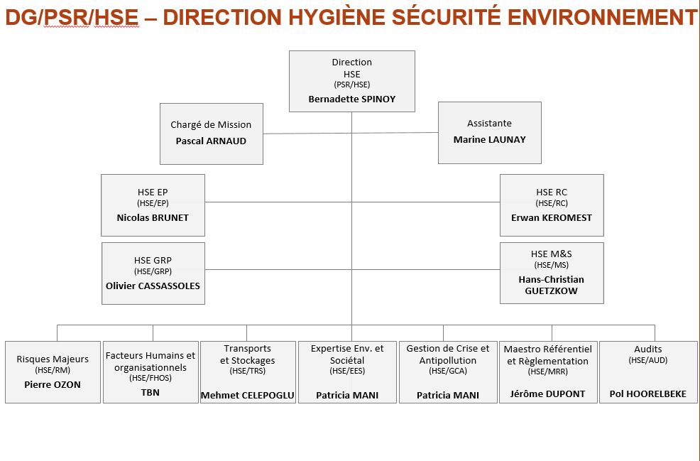
HSE organization on a Group level

