Slide 1
Behaviors
(positive and negative)
Safety Training for New Recruits
Module TCG 4.1

Slide 2
Module objectives
At the end of this module, you:
Will understand that behavioral errors can have major consequences (HIPO, accidents, etc.).
Will know the HSE behavior expected of Total employees.
Will be able to identify positive behavior to be encouraged and negative behavior on which action should be taken within Total.
*HIPO = HIgh POtential incidents

Slide 3
Feedback video

Slide 4
The 3 pillars of safety
Safety rests on 3 pillars:
The way in which the facilities/equipment are designed/built.
A management system (regulations, procedures, responsibilities, etc.)
Human behaviors
Between 60% and 80% of accidents at the workstation
behavioral causes

Slide 5
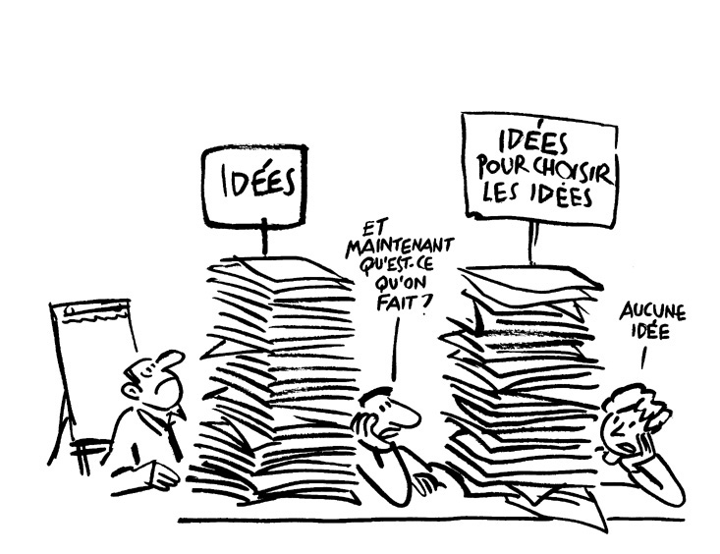
Definition of behavior
Examples of behaviors:
  Speaking to people about safety
  Not applying a procedure
  Inspecting facilities regularly
  Etc.
Examples of other “activities” which are not behaviors:
  Thinking about speaking to people about safety
  Wondering whether a procedure is applicable
  Thinking about the date of the next inspection to be carried out
  Etc.
Behavior = observable action
Behavior ≠ intention
Behavior ≠ opinion
Notes:
The aim is to arrive at the idea that behavior is an observable, tangible action, and not an idea or an intention…
If needed, steer participants by asking them to compare behavior and intention.

Slide 6
Exercise
Behavior or not?
Working at height without a harness
Being stressed
Taking a Safety Tour
Suggesting one of your colleagues take a Safety Tour
Convincing yourself that safety is your priority
Driving the wrong way on the highway
Action?
Observable?
Notes:
Safe behaviors are not so easy to adopt. Sometimes, we need to change our practices, to learn, to evolve… that is why it is all the more important to recognize them, to value them as a way to be closer to colleagues. I would like you to look together at the way in which good and bad behaviors are dealt with at Total.

Slide 7
Adopt good safety behavior
General feeling that avoiding accidents is innate
Actually, safe behavior is neither logical nor natural
Safe behavior is learned
Know the regulations and apply them

Slide 8
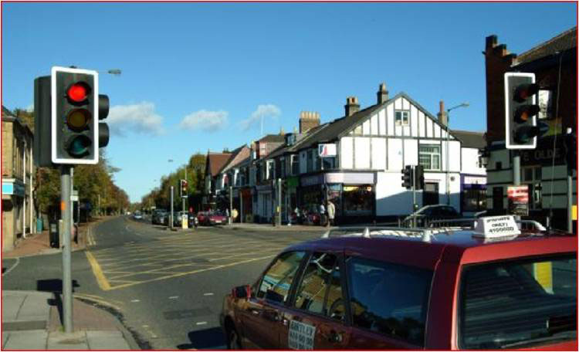
Adopt good safety behavior
For example:
All drivers know to stop at a red light
It is neither logical nor natural to stop at a straight line without traffic when there is a red light
However, we have learned that it is necessary to stop

Slide 9
DEALING WITH GOOD BEHAVIORS
Total employees are expected to:
Respect the regulations, have exemplary conduct, responsiveness, etc.
  Encourage all practices that comply with the regulations on a daily basis
Recognize a proactive attitude
  Encourage proactive attitudes (initiatives, active contribution, reporting difficulties and suggesting solutions, etc.) rather than just the outcomes
Promote an action or behavior
  Reward significant actions, exemplary behaviors, etc.
Practice recognition on a daily basis
Notes:
These behaviors are also expected of our contractors.

Slide 10
Dealing with behavioral deviations
Difference between fault and error
Fault: intentional in nature
Need to react with an appropriate penalty
Error: not intentional in nature
Need for education
Any deviation must lead to a reaction

Slide 11
Behavioral deviations
Speeding on-site
Forgetting a big step in a procedure
Bringing alcohol on-site
Not understanding a plan or procedure
Not using the PPE provided
Confusing two chemical products
Driving a site machine without wearing a seat belt
Using a phone while driving
Opening a different valve to the one indicated in the procedure because you don't think it is the right one
Intentional?
Not intentional?

Slide 12
Assessment of the type of deviation
Notes:
This flow diagram shows the logic analysis of a deviation to decide whether it is a fault or an error.

Slide 13
Reaction adapted to the deviation
In the event of a deviation, all measures must be implemented to avoid a re-occurrence of the deviation:
React and dare to say… by using the Stop Card.
Bring up the event
The reaction must be adapted according to:
the nature of the deviation
the potential gravity of its consequences
Room for error exists
Notes:
The stop card is, of course, an essential tool in reacting to the deviation.

Slide 14
summary
Behavior = observable action
Behavior ≠ intention
Behavior ≠ opinion
Know the regulations and apply them
Practice recognition on a daily basis
Any deviation must lead to a reaction
Room for error exists

