Slide 1
Teamwork, Relationships with Management/APR
Safety Training for New Recruits
Module TCG 4.2

Slide 2
MODULE OBJECTIVES
At the end of this module, you:
Will understand the added-value of teamwork (collective vs. individual).
Will understand the importance of expressing yourself if in doubt about safety.
Will understand the importance of the HSE component during the APR and will be able to establish the link between aspects of the HSE policy.

Slide 3
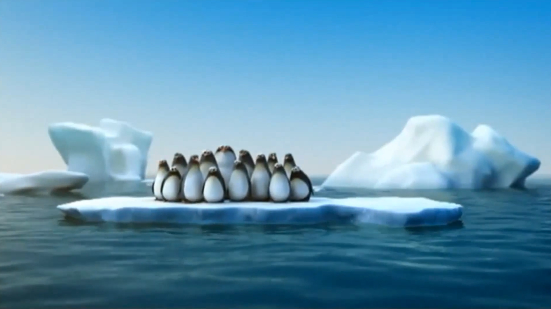
FILM: Collective strength

Slide 4
The benefits of team work
The “collective strength” team dimension is a cornerstone for safety:
Power of solidarity
Different experiences
Different knowledge
Importance of a fresh eye
Strength through cooperation

Slide 5
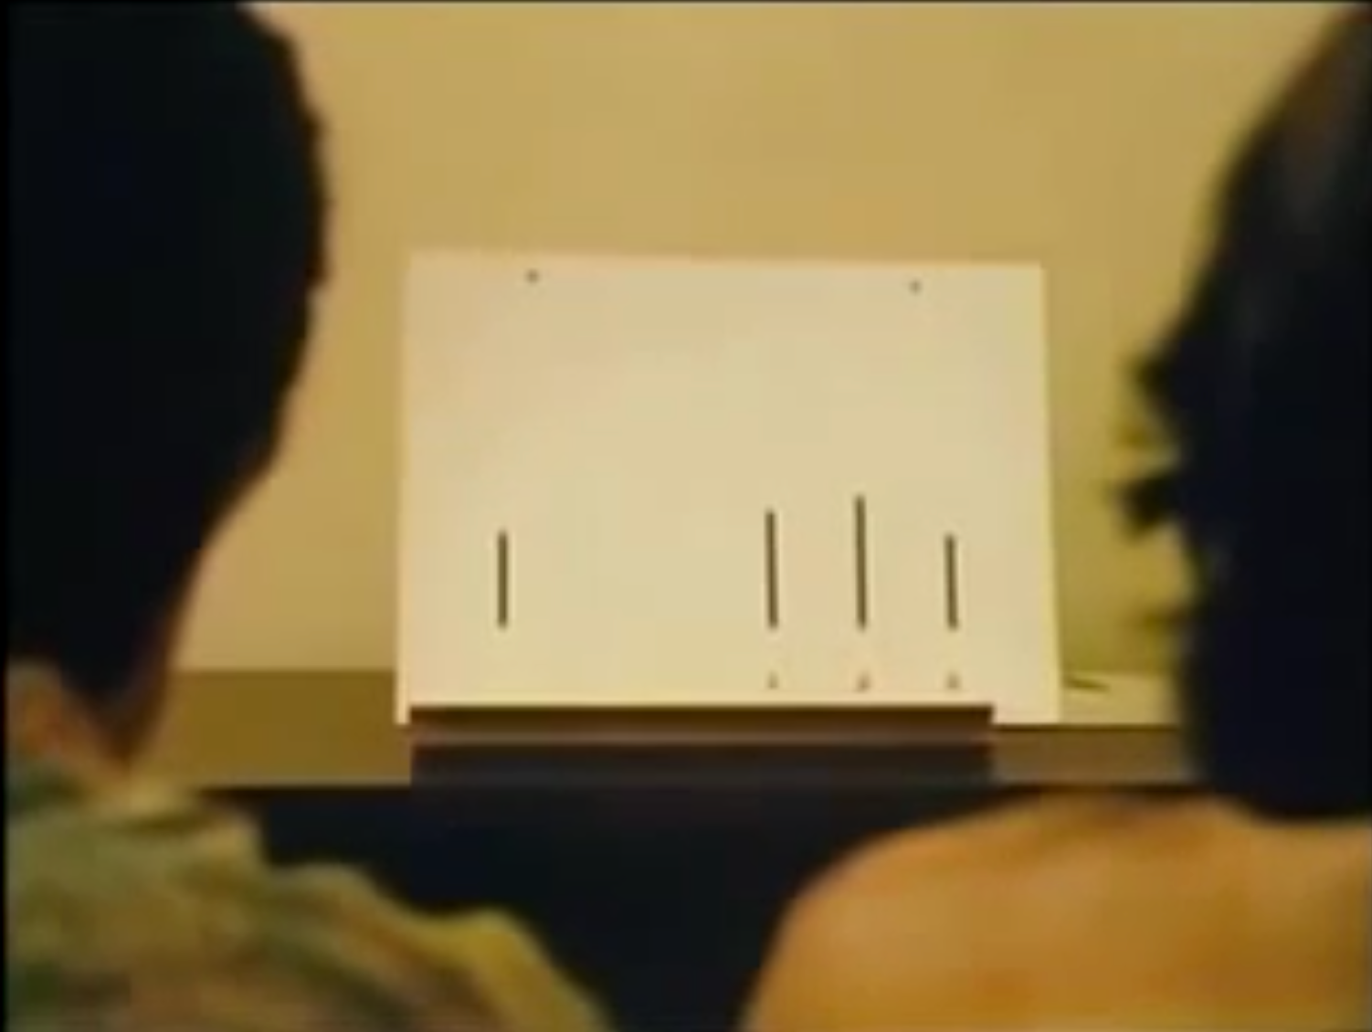
FILM: Compliance with the group

Slide 6
Influential factors
The individual behaviors within a group can be influenced by various factors:
Pressure from colleagues
Seeking recognition from colleagues
Wishing to impress others
Contractual pressure for contractors
Cultural pressure (the boss always is right!)
Etc.

Slide 7
workshop
Instruction:
"List the problems that can arise from complying with group decisions when someone feels that something is not right."
Work in pairs (10 minutes)
Presentation in pairs

Slide 8
Risks caused by the group effect
If you are in any doubt, saying nothing or not asking anything can in itself present risks:
Missing something major if you are right
Remaining convinced that it cannot work
Allowing complacency to be introduced
It is essential that all members of the team completely understand the decisions taken by line managers before starting work.

Slide 9
Banana experiment
Five monkeys were placed in a cage, above which a banana was hung (out of reach).
A ladder was placed in the cage, allowing access to the banana.
Each time a monkey tried to climb up the ladder, all the monkeys were sprayed with cold water
The monkeys quickly learned to stay away from the ladder!
Ref: Dr. H. Harlow
University of Wisconsin - Madison

Slide 10
Banana experiment
One of the “tested” monkeys was replaced with a new monkey which had not yet learned “how things work”
The new monkey hastened to go up the ladder to grab the banana.
Ref: Dr. H. Harlow
University of Wisconsin - Madison

Slide 11
Banana experiment
As soon as this monkey tried to go up the ladder, the others monkeys, fearing they would be sprayed, prevented it from climbing up.
The fact is that there was not even any need to spray the new monkey to prevent him from climbing the ladder and for him to forget about the banana.
Ref: Dr. H. Harlow
University of Wisconsin - Madison

Slide 12
Banana experiment
One by one, the five original monkeys (which had been sprayed) were replaced.
The scenario was repeated with each new monkey, until no monkeys had tested the spray.
Ref: Dr. H. Harlow
University of Wisconsin - Madison

Slide 13
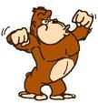
Banana experiment
One of these “second generation” monkeys was replaced in turn, and the scenario was repeated again.
Without directly understanding the reason why the ladder was not to be used, all the monkeys had become the "keepers” of the “rule”.
Ref: Dr. H. Harlow
University of Wisconsin - Madison

Slide 14
Banana experiment
We call it “collective conscience”, “the way we have always done it”, “the way things work here”
In our world, the outcomes are the same:
Proliferation of bad habits, negative conditioning, repression of questioning… can be very frustrating for whoever is trying to initiate a positive change, in particular when it involves behaviors.
Ref: Dr. H. Harlow
University of Wisconsin - Madison
Notes:
Note that this group effect can have positive consequences, particularly regarding compliance with basic safety regulations. But when it is inappropriate behavior that is reproduced by the group effect, reversing the trend is very complicated, safety initiatives taken being seen as questioning the rule of thumb.

Slide 15
LAUNCH MEETING

Slide 16
What is expected of the manager
To link messages with practices:
Follow words with actions.
Give honest feedback on resolute actions.
Encourage reporting in a hazardous situation.
Listen to the contractors and the staff representatives.
Open a discussion on contradictions between the regulations and the instructions.
Let everyone have their say.
Ensure that you provide clarifications should anyone have any questions.
Decide who should arbitrate should a situation arise.
Take the reality of the field into account when defining the tasks
Listen to your team

Slide 17
What is expected of everyone
Involvement of everyone:
Express/revisit any doubts concerning a situation.
Respect what your colleagues say.
Report any anomalies/deviations.
Create/revise the regulations/procedures.
Feedback.
Always express any doubts.
Saying nothing about a major risk will not make you a hero, even if an accident does not happen

Slide 18
Annual performance review and the H3SE
What are the intentions of an APR?
Is an H3SE component integrated into the APR?

Slide 19
APR and H3SE performance
H3SE objective of the APR: to develop everyone's H3SE performances.
Achieving individual H3SE objectives contributes to Total's H3SE performance.
Examples of individual H3SE objectives linked to the Group's H3SE objectives:
… See P5 booklet

