Slide 1
Everyone is responsible for HSE on their own level
Safety Training for New Recruits
Module TCG 4.4

Slide 2
MODULE OBJECTIVES
At the end of this module:
You will understand what safety culture means and what that means at Total.
You will know your role: to make decisions in compliance with and based on the regulations and instructions.

Slide 3
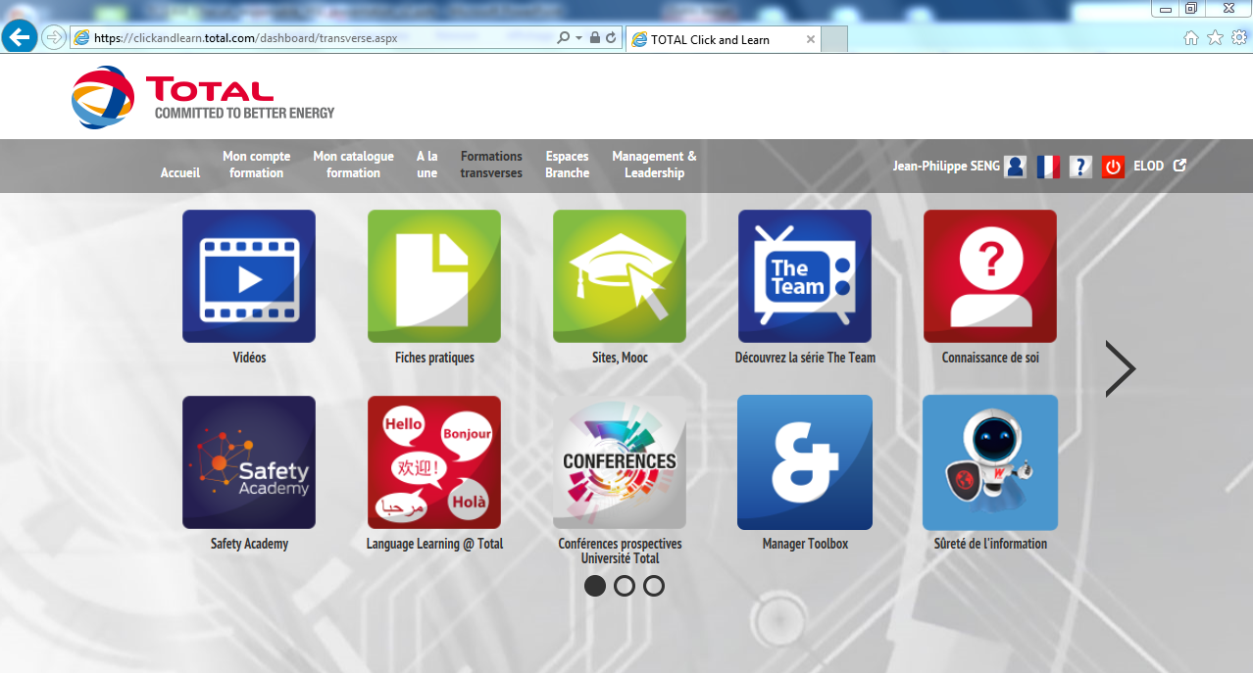
Safety Academy

Slide 4
E-learning

Slide 5
What is safety culture?

Slide 6
The 4 types of safety culture

Slide 7
The 4 types of safety culture
Procedures, operating methods, instructions… are emphasized and are part of a management system.

Slide 8
The 4 types of safety culture
Exchanges of best practices between staff from the same profession (on-the-job training on-site by the most experienced)

Slide 9
The 4 types of safety culture
Based on the idea that certain activities are dangerous and casualties cannot be avoided.

Slide 10
The 4 types of safety culture
Based on the idea that Safety must be present in all areas of the company or organization and that it is a responsibility shared by all stakeholders. The management approach emphasized is more participative.

Slide 11
Advantages/disadvantages
Managerial culture
Corporate social culture
What do you think are the advantages and disadvantages of each of these cultures?

Slide 12
Total targets an integrated safety culture

Slide 13
Total targets an integrated safety culture
The best of the corporate social culture and managerial culture:
Regulations available.
The regulations have been tested.
The context of the application of regulations was known during drafting.
People are involved in the application of regulations.
Qualified and experienced people are always in place and work under satisfactory conditions to analyze the situations.
A third party can be contacted for an independent analysis.
People have the means and the authority to act in all situations.

Slide 14
I am committed to my own safety
Know your role
Be attentive, vigilant, alert
Do not let yourself be guided by routine
Do not fear – assume
Engage, comply with and apply the basic regulations, be proactive and report any anomalies
Accept remarks and encourage them; accept criticisms as well:
Whatever the management level
Whatever the employer
Whatever the profession
FOR ME

Slide 15
I am committed to the safety of my colleagues
Intervene
Do not be afraid to speak out
Do not remain passive when faced with a situation
Be convinced of my usefulness
Do better
Express myself and listen
Share my experience and my skills
FOR YOU

Slide 16
I am committed to the safety of everyone
Be aware of the risks that surround us:
You
Me
Our colleagues
Our residents
Our friends
Our families
Etc.
FOR ALL

