Slide 1
Anomaly Reporting
Safety Training for New Recruits
Module TCG 5.2

Slide 2
Module objectives
At the end of this module:
You will understand what an anomaly is and why it is important to deal with them.
You should know the anomaly reporting tool for your Branch.
You will be able to identify anomalies linked to the golden rules.

Slide 3
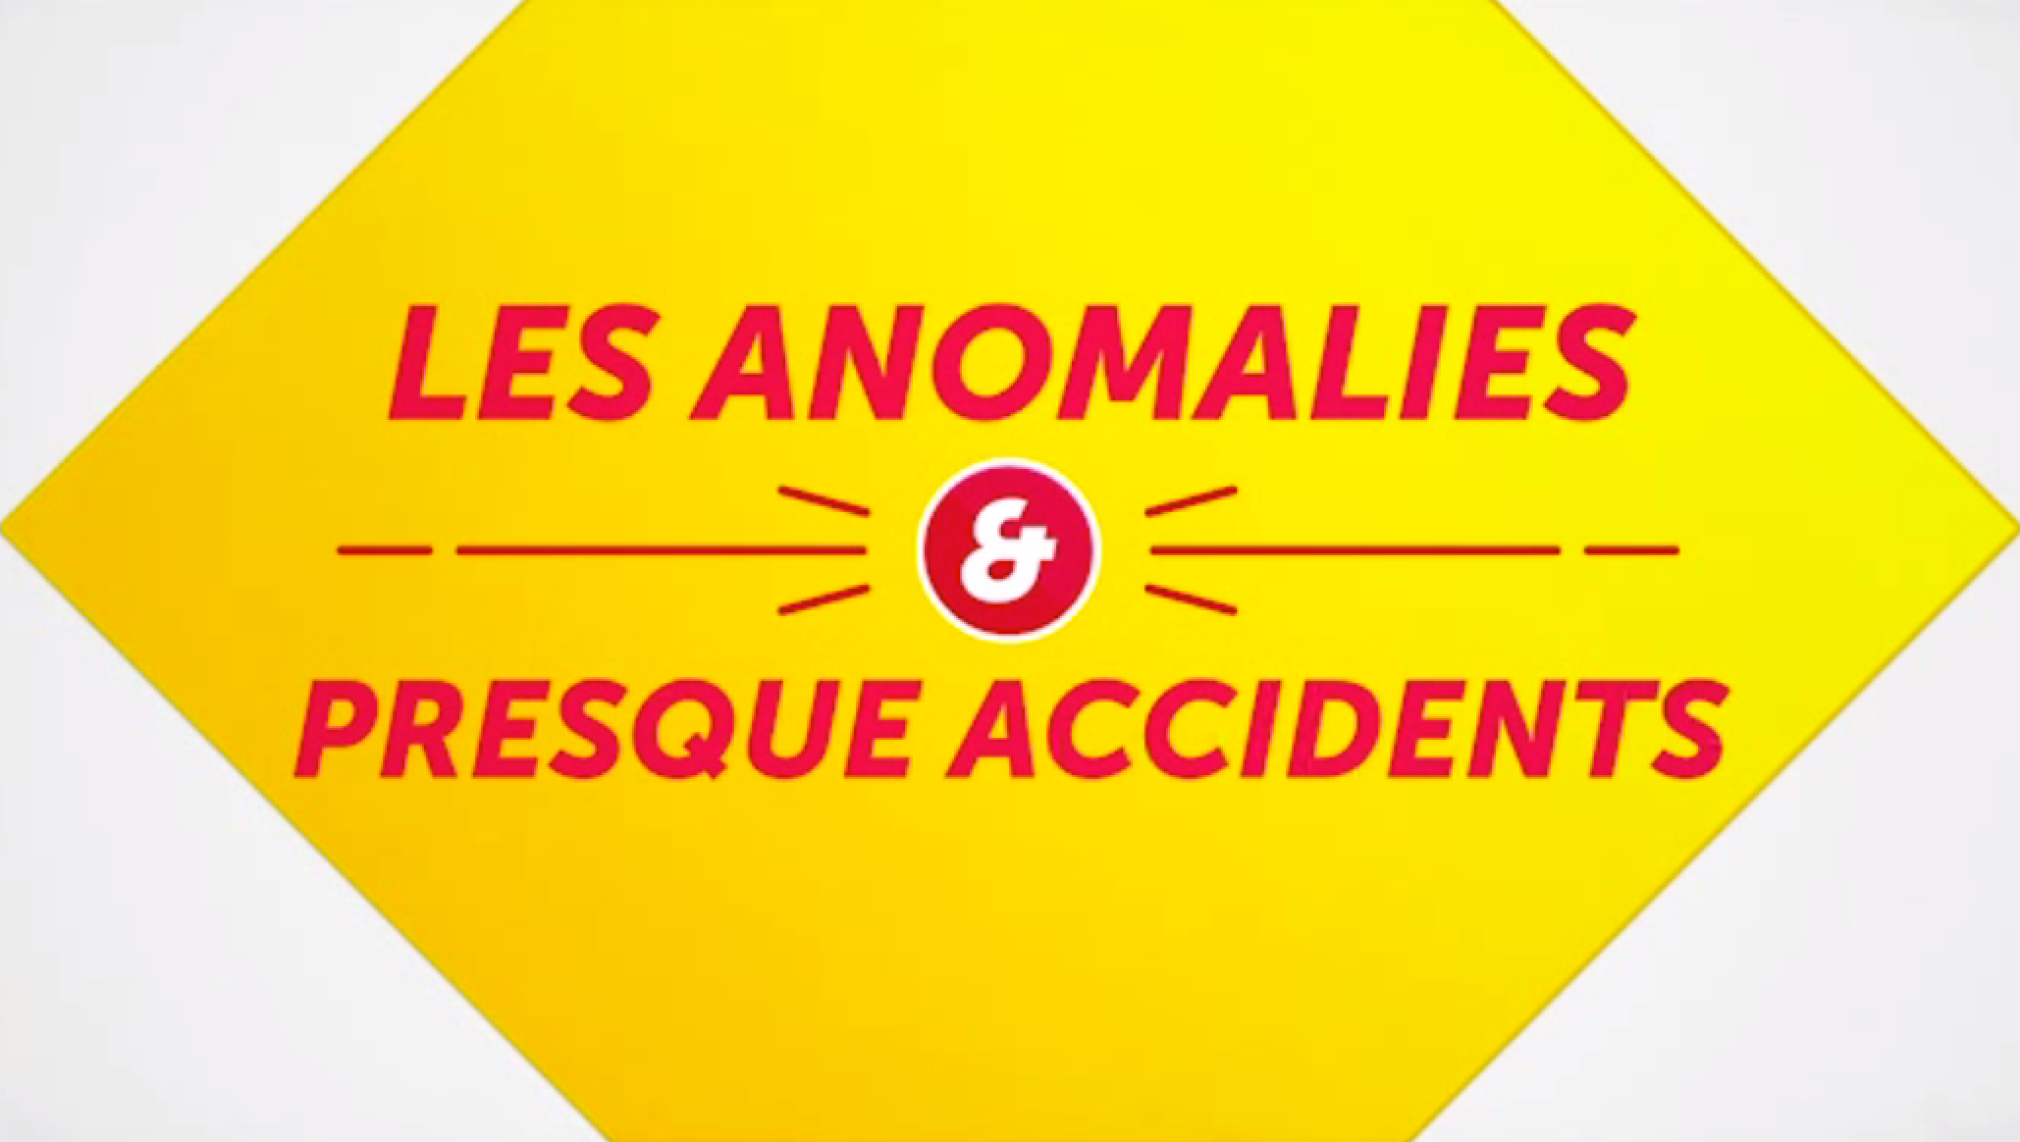
FILM: Anomalies

Slide 4
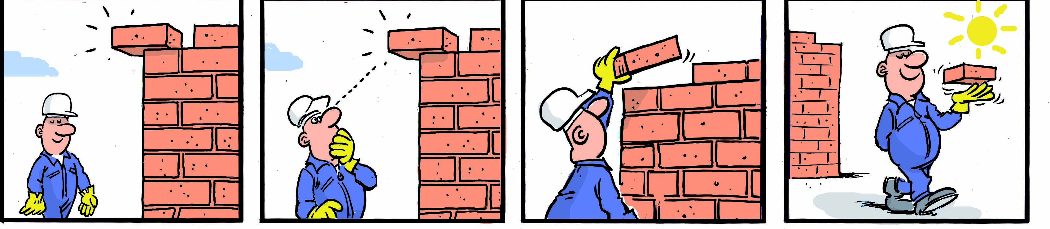
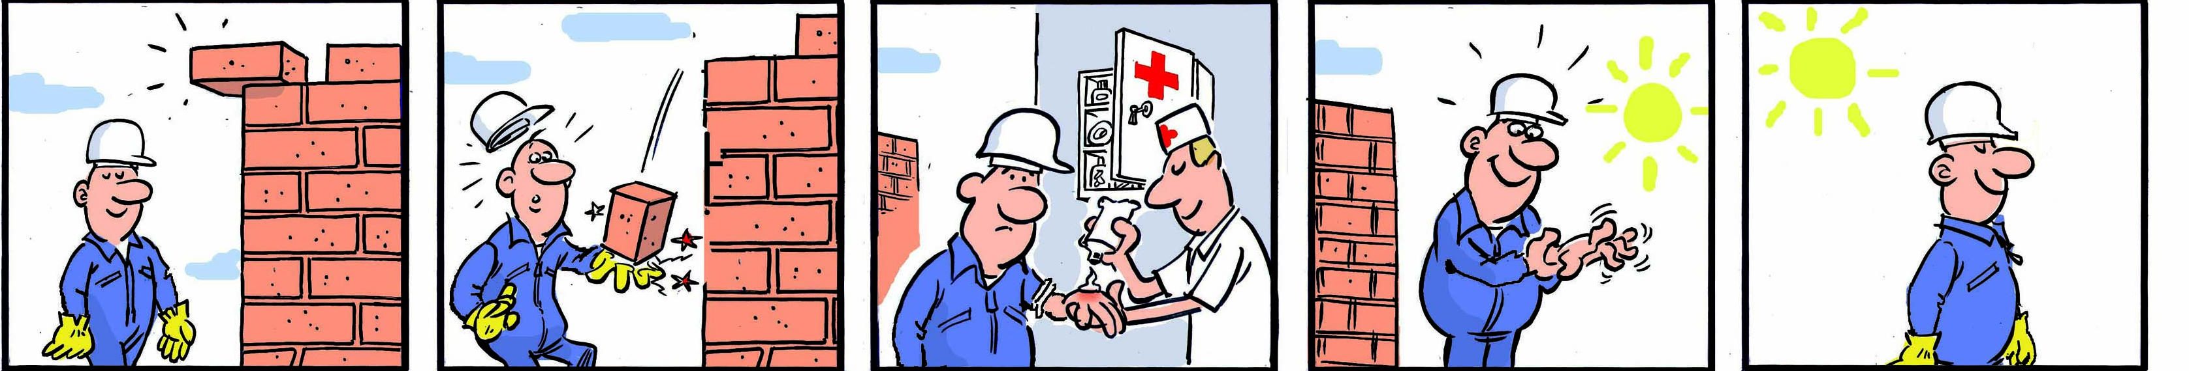
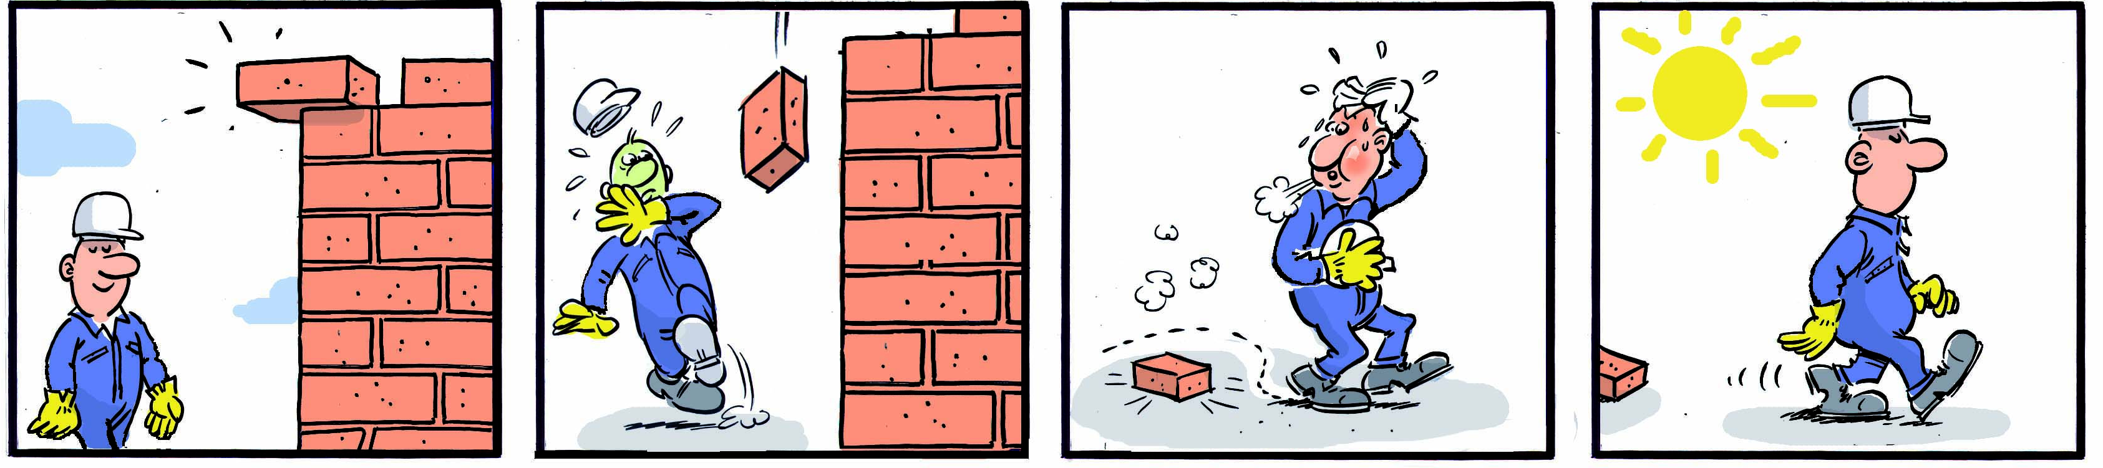
What is an anomaly?
Anomaly: Any abnormal situation or action, i.e. one that deviates from an established standard, regulation or procedure. Without immediate consequence.
Incident/Accident: An undesirable event or series of undesirable events resulting from a combination of hazards and/or a combination of anomalies. With direct consequences.
Near-accident: Any event which, under other circumstances, would have had the consequences of an accident. Without immediate consequence, but with potential consequences.

Slide 5
The bird pyramid
Severity
Death
Anomaly/Dangerous situation
First aid
Near-accident
Injury with labor disruption
Case requiring a medical treatment + work adaptation
HSE event
INCIDENT
TRIR

Slide 6
Some practical examples
Situation 1:
During a lifting operation, the load descends uncontrollably and stops one meter from the ground. No consequences.
A lifting operation is carried out without authorization.
During a lifting operation, the load descends uncontrollably and falls to the ground. There is material damage.
Situation 2:
An object is in the middle of the road, the driver sees it and avoids it at the last moment. There is no consequence.
A driver loses control of the vehicle, leaves the road and rolls over. The driver is wounded and the vehicle damaged.
An employee drives a vehicle that has exceeded its inspection date.

Slide 7
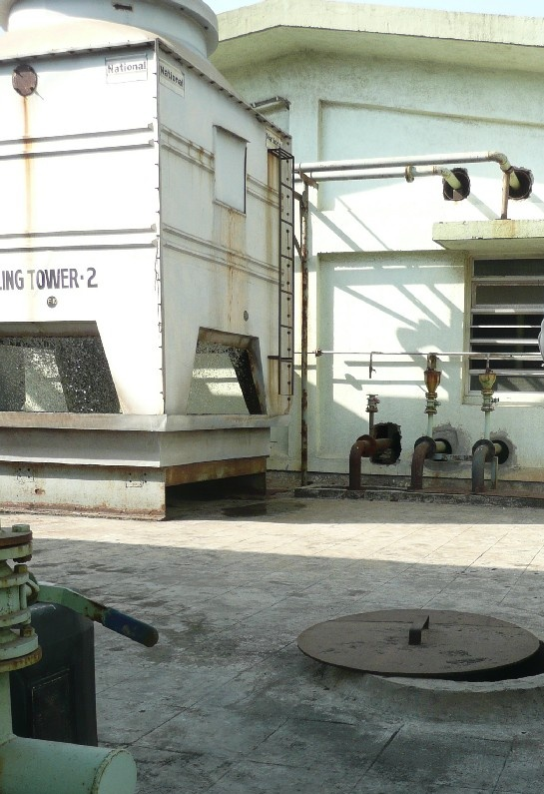
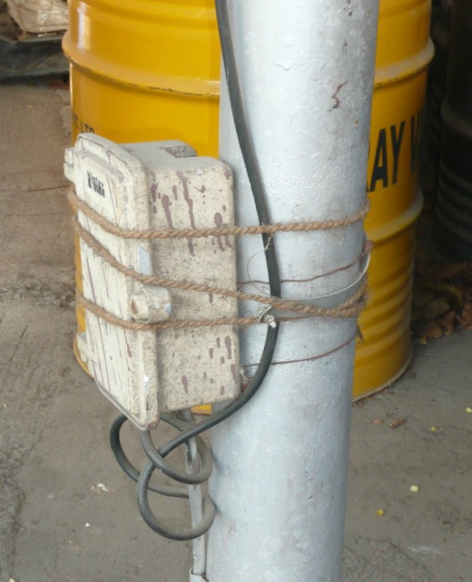
Some practical examples

Slide 8

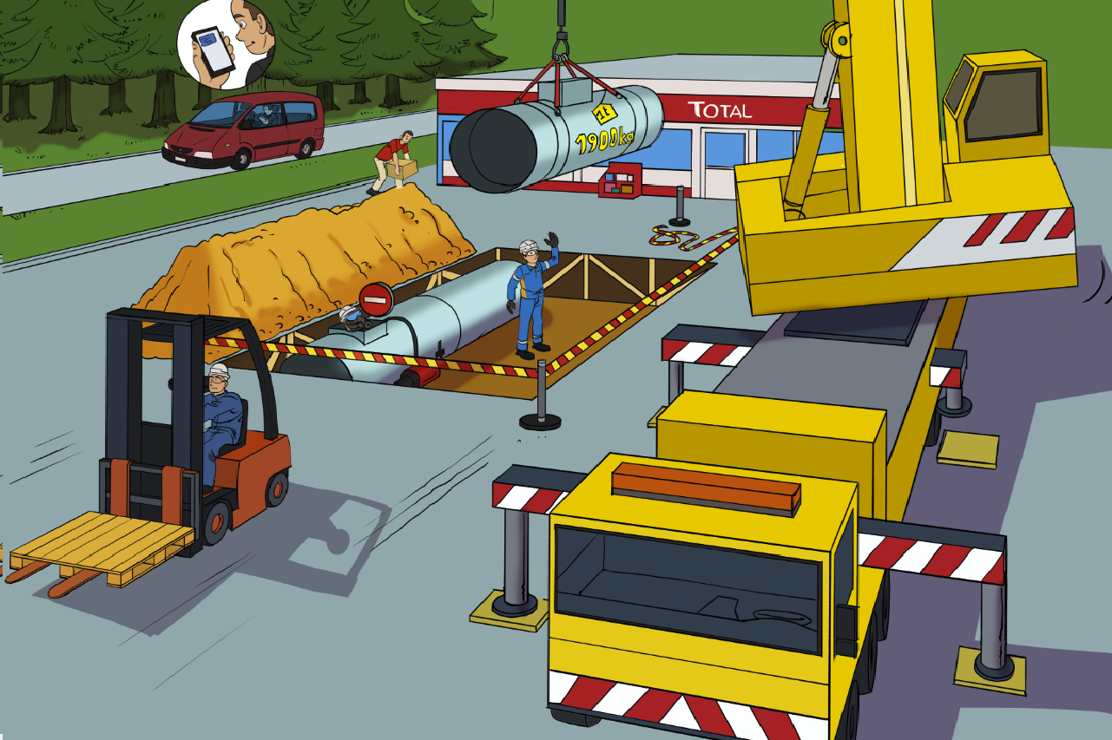






ANOMALIES AND GOLDEN RULES

Slide 9
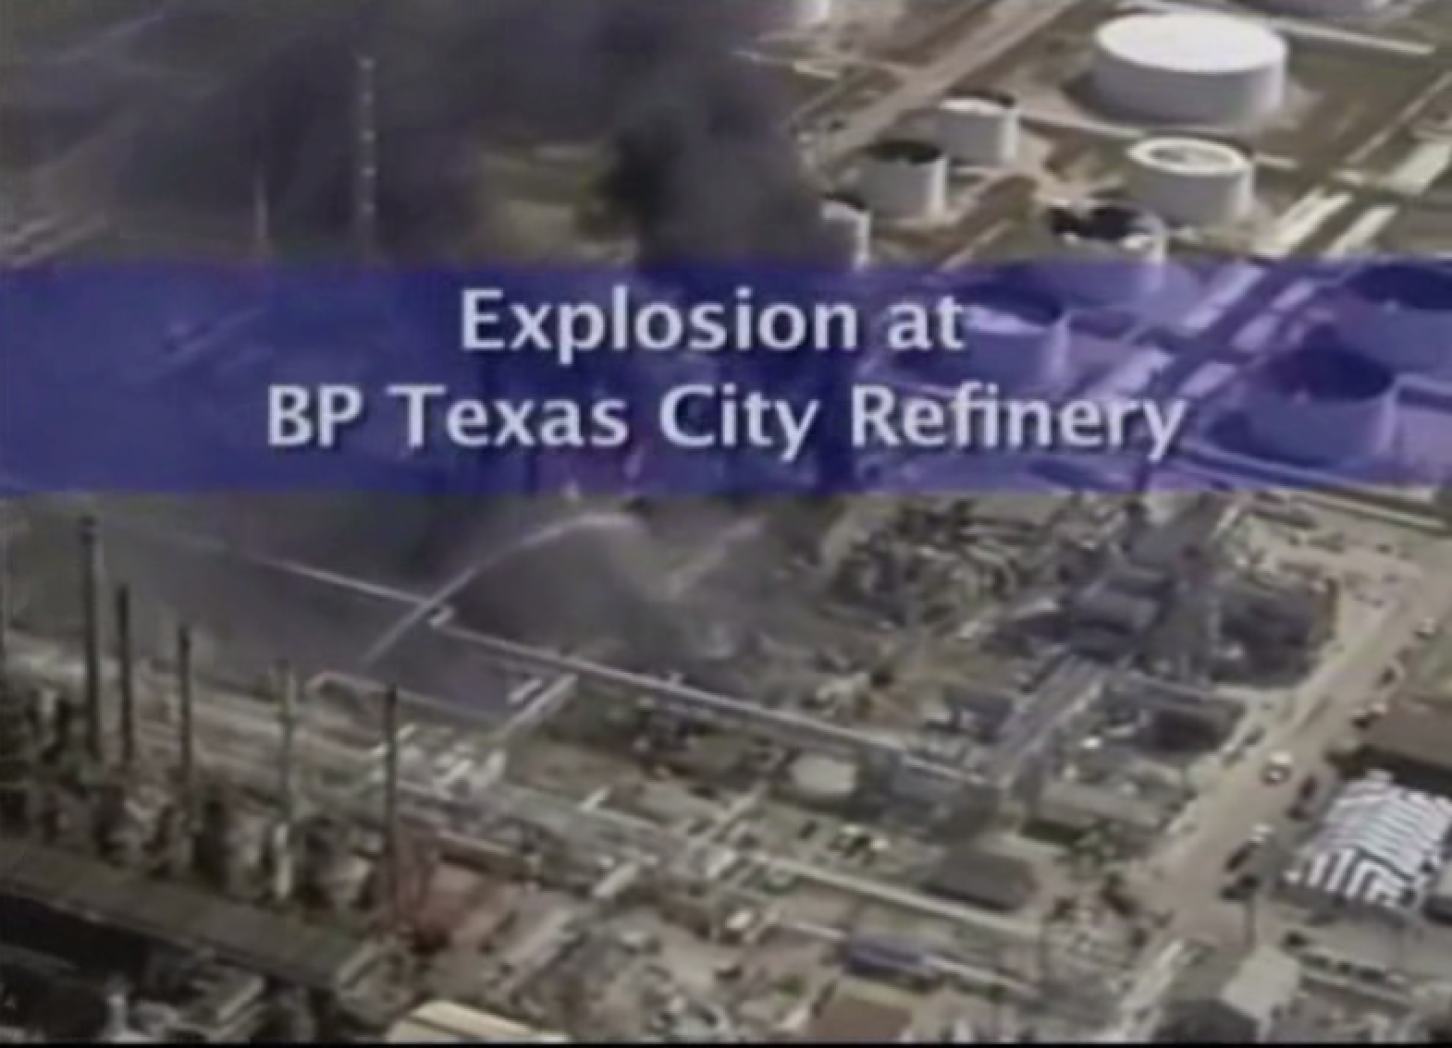

Slide 10
SUMMARY OF ANOMALIES
It is essential to identify then report anomalies so that they can be corrected.
Potential causes of incidents/accidents with sometimes serious consequences (from material damage, to injury, to death).
When you notice an anomaly, you must correct it when you can, and flag/report it to be processed and corrected by the contact for your site/subsidiary.
A useful resource: the STOP card.
A common HSE practice for the Total Group through DIR GR SEC 002.

Slide 11
REPORTING TOOL
Show a slide presenting the reporting tool specific to the branch.

