Slide 1
Feedback
Safety Training for New Recruits
Module TCG 5.3

Slide 2
Module objectives
At the end of this module:
You will know what feedback is used for
You will understand its usefulness/importance in the management system

Slide 3
An actual situation
Jean has recently bought a motor bike. He always dreamed of having one and bought it with limited resources. Therefore, he had to settle for a deal.
After a few hundred kilometers, he realizes that the bike has "problems": at times, it loses power.
Jean has limited knowledge of mechanics, but he thinks it must be the spark plug, or the carburetor maybe...
Despite his limited knowledge, he is resourceful and thinks he can handle the problem himself. But he does not want to make mistakes that could worsen the vehicle's predicament, or worse, hurt him.
Help Jean find solutions to his problem while ensuring his safety.
How can he find the source of the problem by himself?
And, once he has found the problem, how will he be able to find the resources to fix it?

Slide 4
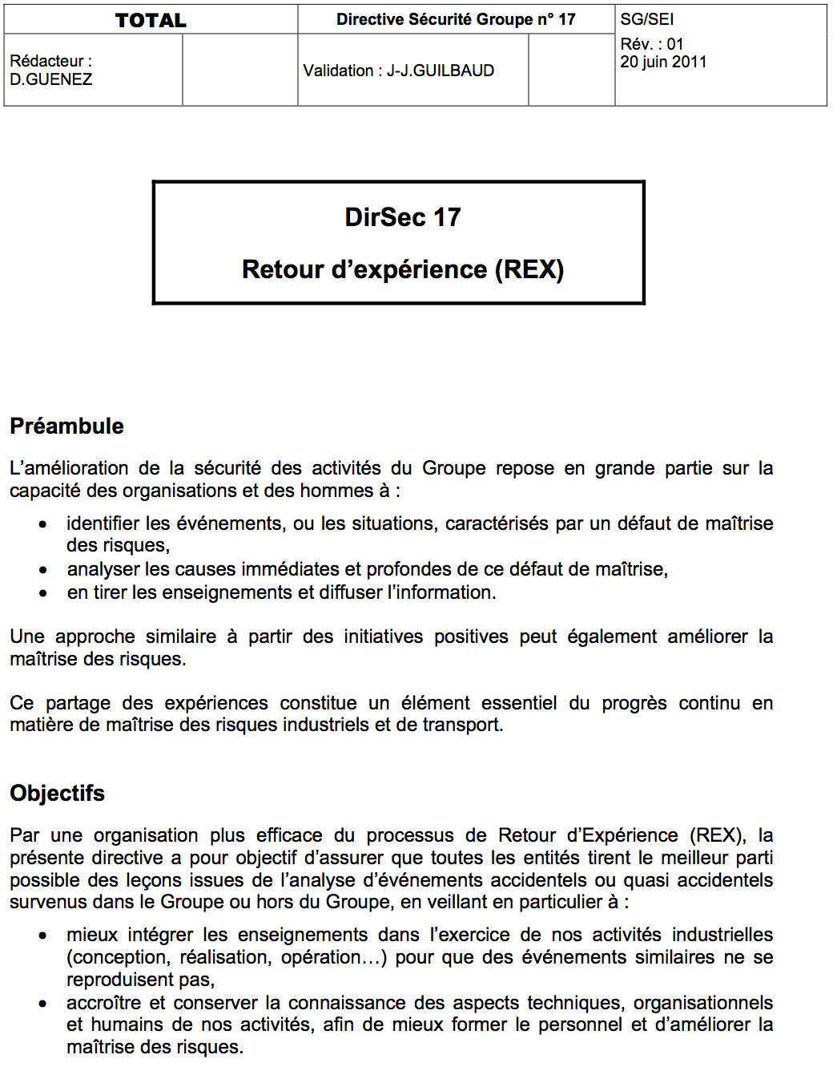
DIR GR SEC 017

Slide 5
HOW FEEDBACK WORKS IN A REFINERY

Slide 6
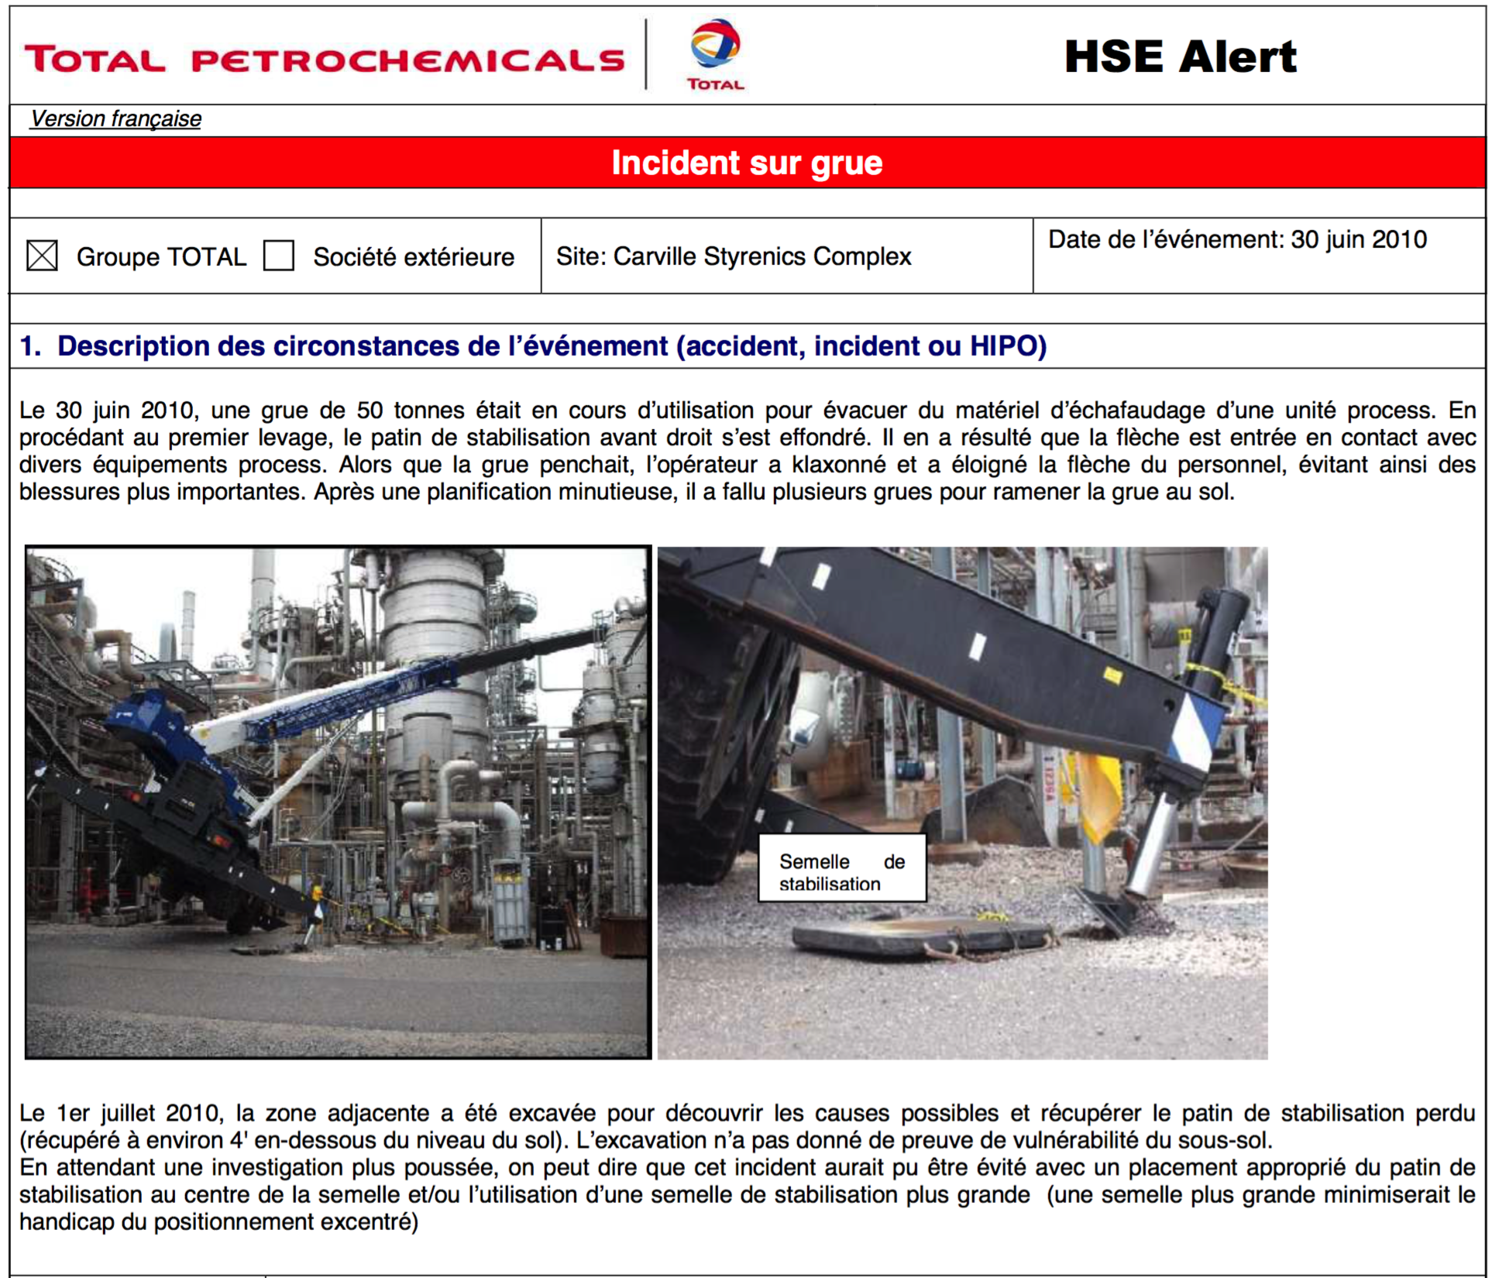
Feedback example – Overturned crane

