Slide 1
Stop card
Safety Training for New Recruits
Module TCG 5.4

Slide 2
Module objectives
At the end of this module:
You will understand the significance of using the Stop Card.
You will be able to use the Stop Card in simple situations.
You will be aware that there are no penalties in the event of misuse.

Slide 3
THE STOP CARD: WHAT'S IT FOR?
To give everyone the means to intervene and encourage them to do so in order to move forward in terms of safety
All accidents can be avoided. In particular, this involves shared vigilance, for ourselves and our colleagues, as well as for those around us.
The Stop Card, which is applicable to all Group entities, allows all of the company's stakeholders, Total employees and contracted operators, to act.

Slide 4
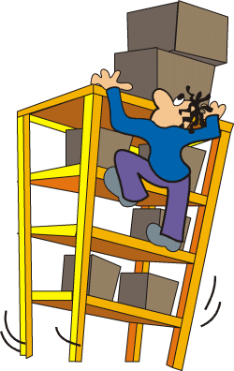
Before the stop card
I don't dare intervene
I don't know this type
I am not the contracting party
Do I have the right?
And if I am mistaken?

Slide 5


After the stop card
STOP

Slide 6

WHAT IS A STOP CARD?
A tool which gives all Total employees and contracting companies the authority to intervene and stop work in progress if they notice actions or situations which appear dangerous or likely to lead to an accident
With a guarantee that they will not be penalized, by Total or by the management of the contractor company, even in cases where the card is misused.
A card establishes this tool
  signed by the General Manager for your entity,
  co-signed by the management of
  contracted companies for their employees.
  provided by your manager.

Slide 7
HOW DO YOU INTERVENE?
An action or situation is dangerous to one or more people, for a facility or for the environment
Engage in a discussion with your concerned colleagues
(operators and supervisors) to resolve the problem
before resuming work
  by asking a simple question to ensure that there is no risk
  If the problem is not immediately resolved, work is suspended pending appropriate measures
Intervene with the Stop Card if necessary
  by stopping the work in progress if the situation so requires
Escalate/contribute to feedback for follow-up within your entity
  Why: to identify ways to move forward and facilitate experience sharing

Slide 8
What is everyone's role?
The operating process is shared within the Group and operators:
All employees
Middle management
Business unit manager
Identify the danger and report
Stop/forcibly halt the work
Take part in the analytical approach to perceived risks
Contribute to resolving the problem, if directly involved
Coordinate the resolution of the problem
Make modifications to the way of working, if necessary
Guarantee that there will be no penalties
Arbitrate if problems could not be resolved
Put a tool in place to record Stop Card uses

Slide 9
THE STOP CARD IN 3 QUESTIONS
I am a scaffolder and I see an operator taking a product sample without safety goggles. Can I intervene?
I used the STOP card but the situation was not really dangerous. Will I be reproached?
I am a purchaser and on the way back to my office, I see an operator performing a grinding operation without a protective cover to prevent flying sparks. Am I right to intervene?

Slide 10
