Slide 1
Office Accidents
H3SE integration kit
TCNT 1.1 module

Slide 2
Module objectives
At the end of this module:
You will know the main risks related to your daily activities in offices and during journeys.
You will be able to tell the difference between good and bad behaviors in the office, and during journeys.
You will know the traffic regulations if you drive a vehicle for Total.

Slide 3
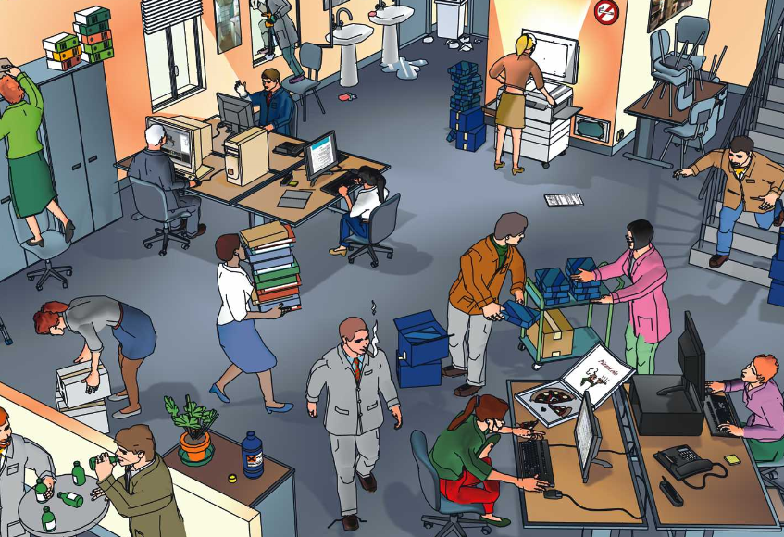

Slide 4
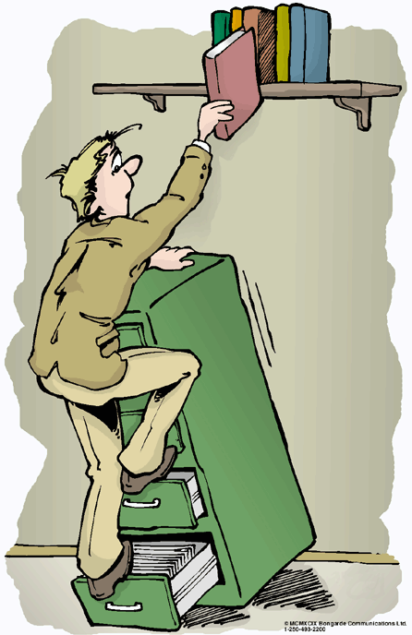
RISKS AT THE OFFICE
TOP 5 accidents in 2015 (M&S)
  Falling on the stairs or while entering/exiting a vehicle
  Stumbling while walking
  Slipping while walking
  Falling/swinging object
  Truck accident
This TOP 5 makes up 50% of TRIRs
10% of accidents happen to office staff

Slide 5
Accidents on the move
Falling on the stairs
  Hold the rail
    While going down and up
  Do not go down steps 4 at a time
  Take the elevator
Stumbling or bumping into something….
  No electrical cables in hallways
  Do not leave your drawers open
  Do not run in the corridors
  Order and layout of the office
Slipping
  Be careful on wet ground (cleaning)
  Report leaks
  Be careful on snow and ice: parking lots
Watch out for the internal traffic in parking lots

Slide 6



Accidents related to office work
Carrying loads
  Use your legs to lift a load, never your back or arms, which must remain straight
    Training!
Be careful of heavy objects placed at height
Cutting yourself
  Use scissors rather than a cutter
  Use a safety cutter
    Wear gloves
Take time to read the equipment instructions

Slide 7
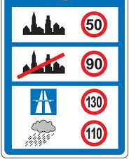
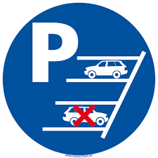


Traffic – Traveling in a vehicle
Respect the speed limits,
adapt your speed to the driving conditions
Reverse park
  To depart again in complete safety
  (and not so you can get out quicker!)
Wear your seat belt
  Buckle up in the front and back
Do not use the phone while driving
  Even with a hands-free kit or headset
  (Group regulation)
Respect driving times
Do not drink and drive!
  Be careful with farewell drinks, seminars, cocktails
    Consider carpooling

Slide 8


Carelessness
Trip hazard
  Do not climb up on a chair with wheels
  Do not balance on the back of your
  chair
  Do not climb on pieces of furniture
Electrocution risk
  Do not tinker with electrical appliances
  Disconnect before any operations
  Report any problems

Slide 9
Good behaviors
Do not run
Do not balance on your chair
Avoid being careless
Hold the rail
Evacuate in the event of an alarm (security/attack, casualty, fire)
Respect the main prohibitions (do not smoke etc.)

Slide 10

Golden rule no. 2 - Reminder

Slide 12




The golden rules at the office
02 – Traffic – Traveling on foot
Stumbling or bumping into something….
  Order and layout of the office
    No electrical cables in hallways
    Do not leave your drawers open
  Do not run in the corridors
Falling on the stairs
  Take the elevator as much as possible
  On staircases, hold the rail while going down and going up
  Do not go down steps 4 at a time
Slipping
  Be careful on wet ground
  Be careful on snow and ice
Getting crushed
  Watch out for internal traffic (parking lots)
  Use pedestrian walkways
  When on an industrial site, be careful of machines and vehicles

