Slide 1
Information Security and Travel-related Security
H3SE integration kit
TCNT 1.2 module

Slide 2
Module objectives
At the end of this module:
You will know the main security risks as regards office activities
You will know the main security risks related to travel and missions abroad
You will know about specific arrangements to be made according to travel destinations.

Slide 3
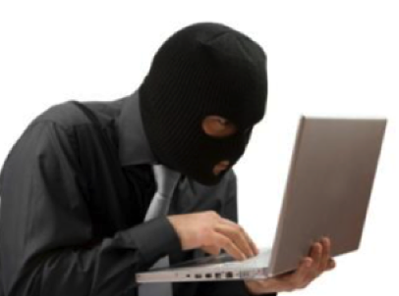
Some figures related to informational assets
2014: Edward Snowden reveals that the American intelligence agency targeted the Total Group and other industrialists (Thales, Siemens, etc.)
30% per annum: the increase between 2006 and 2014 of the targeted thefts of laptops containing proven sensitive information.
3: without any precautions, it is possible to obtain sensitive information through a network of only three people.
20%: percentage of attacks targeting strategic information by persons not belonging to the company but present on premises.

Slide 4
PROTECT YOURSELF FROM INTRUSIONS (PHYSICAL AND DIGITAL)
Protect access to the buildings, always wear your badge, do not open the door to a stranger.
Keep sensitive data and documents locked away and put a theft protection device on your computer.
Memorize your password and do not write it on a Post-it!
Do not use email for messages not related to occupational activity.
Never give sensitive information over the telephone.
Be wary of any suspect email, especially if it is requesting sensitive information – do not click on links or attachments.
Be discrete in public conversations.
No security program is effective without everyone's participation.

Slide 5
LEVELS OF CONFIDENTIALITY
Level 0: Public, e.g. press releases.
Level 1: Internal, e.g. the intranet or technical standards.
Level 2: Restricted to certain authorized employees (documents related to exploration, projects or strategies)
Levels 3 and 4: no precise example, it is confidential (3) (amount of bids in the invitations to tender) or secret (4)!

Slide 6
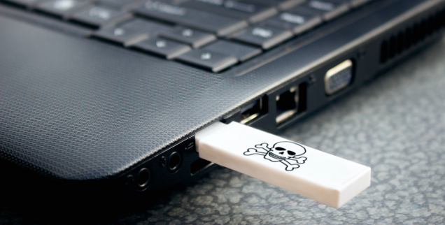
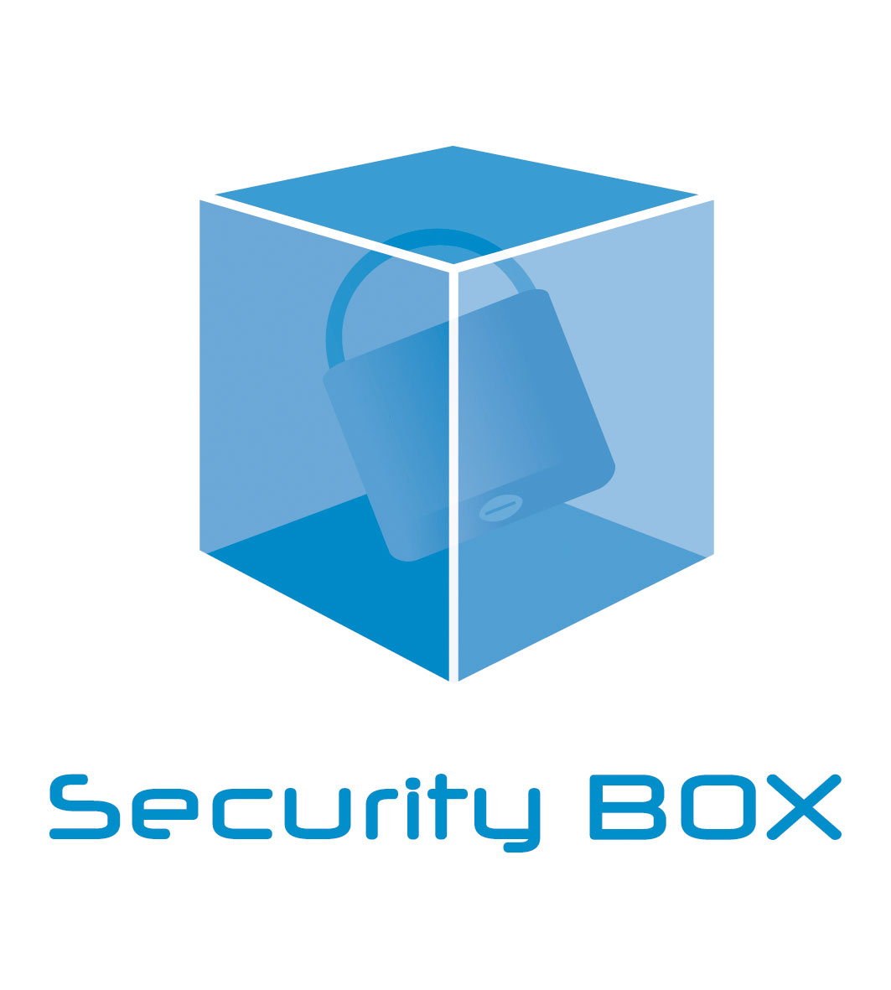
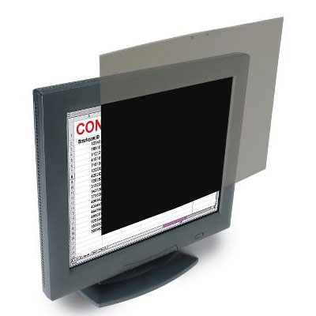
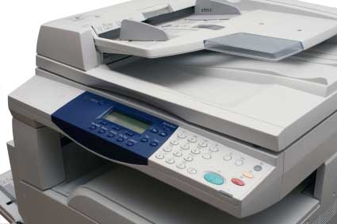
DATA-PROCESSING REGULATIONS (1/2)
Never allow a third party to connect to your workstation, or even connect a removable media to it. Always recover a document provided by a third party with your own USB key.
Make sure that your sensitive information is placed in a virtual vault (for example, through Security Box).
Make sure that no third parties can view your computer screen by installing a privacy filter on your screen.
Printing documents: do not leave documents in the printer. For sensitive documents, use a USB printer in your office.

Slide 7
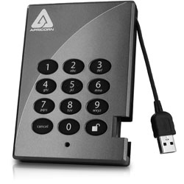
DATA-PROCESSING REGULATIONS (2/2)
Social networks (Facebook, Twitter, etc.):
Do not communicate professional information which could be used to the detriment of the Group.
Use common sense and do not publish information that you would not entrust to a stranger in the street…
On the move, avoid carrying sensitive data: use an encrypted space on the Total network or, failing that, an encrypted USB key to keep on you at all times: this reduces the risk of a computer theft or a hard drive copy, notably at Customs (legal in the USA, China, Israel, etc.).

