Slide 1
The Top 5 Accidents Linked to Violation of the Golden Rules Resource Documents
H3SE integration kit
Module TCT 2.2

Slide 3
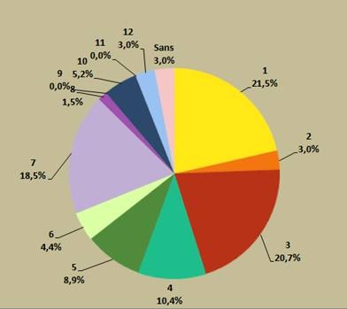
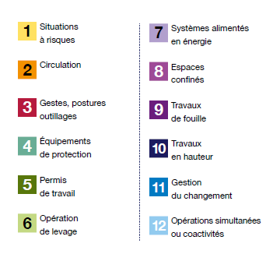
Distribution of Group accidents 2010 - 2016 - Accidents with real consequences > or = 4 - HIPO with potential consequences > or = 4

