Slide 1
RISK ANALYSIS Resource Documents
H3SE integration kit
Module TCT 5.1

Slide 2
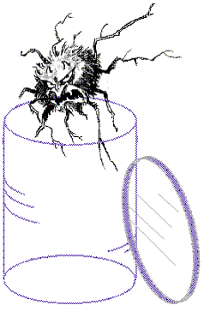
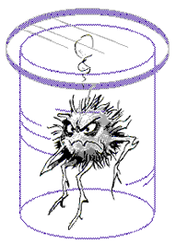
HAZARD OR RISK?

Slide 3
HAZARD
A cause capable of altering something (physical injury, damage to the environment or property damage, or a combination) that legitimizes a concern, or that constitutes a threat that will compromise the good condition or existence of something.
Examples of E&P safety hazards
Fluids that are toxic, flammable, explosive, corrosive, hot, etc.
Power-loaded systems
Extreme environment: climate, offshore oil rig, DW, etc.
Road, marine, air logistics operations
Tool handling
Work at height
Lifting operations and handling
Etc.

Slide 4
Example of the difference between hazard and risk
For a risk to exist, there must be an exposure to a hazard.
Driving at speed is a hazard
Only those in contact (actual or potential) with a car (driver, passenger, pedestrian) are exposed to the risk of accidents. If you do not use a car or you do not go out on the street, you are not at risk.
The risk is inherent in any human activity.
As you cannot live without leaving your home, you will be exposed to a car accident risk. The risk of accidents must therefore be limited to an acceptable level.

Slide 5
RISK
Probability of the undesired event occurring
The probability of an incident is an estimation based on the report of the incidents which take place. It is expressed in the number of times that an event could affect a person.
The probability is defined by the answer to the question: is an incident likely to occur?
Severity of the effects on man, the environment, the plant and the media impact.
The consequences of an incident are measured by answering the question: How would the worst possible realistic outcome be classified if the hazard evolved into an incident?

