Slide 1
Our Lives First : Zero Fatal Accidents

Slide 2
Striking survey results performed in 2019
Key figures: 2,300 responses, 700 contractor employees, 1,500 frontline workers and supervisors
20 %
Not aware of Group’s objective: « Zero fatal accident »
20 %
Did not stop any work for safety reason within the last semester
40 %
Their manager only conducts safety tours on a quarterly basis or less
50 %
Not controlled on a daily basis with regard to compliance to safety rules

Slide 3
what are contractors saying to management:
Get back in the field
Talk one language
Check compliance to your rules

Slide 4
The 3 actions
FOR WHICH:
Total will focus on the Top 5 fatal work risks (Work at height, LOTO, Hot work, Lifting, Confined spaces)
Contractors are key stakeholders
Contractors will partner in implementing the three actions
D – Day is April 30th (WDFS)
“Safety Green Light”
Joint Safety Tours
Life Saving Checks

Slide 5
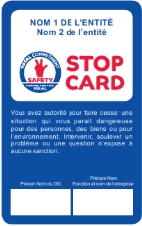
SAFETY GREEN LIGHT
Objectives:
Raise awareness of life-threatening hazards through a final work check.
Step back when you perceive uncertainty of a safe execution. Compare perceptions.
Enable a final GO/NO GO gate
Common challenges to overcome:
Production pressure
Deference to Authority
Bystander passivity
Afraid to speak up

Slide 6
What is the tool?
SAFETY GREEN LIGHT?
What: pre-job ritual to reflect on life-threatening hazards
Who: all personnel involved in the task including Total personnel if present
Where: on all sites (including remote) for all works performed under a permit-to-work
When:
Every job under a work permit
Everything is ready to start a job
Every time a job is about to start, to re-start, after a shift handover and any modification
How long: few minutes, must be quick
How:
Standard included in HSE Company Rule related to Permit to Work (CR-GR-HSE-402)
Each worker reflects on the four questions and interact with his co-workers
Each worker signs at the back of the permit-to-work prior to starting
1
What is the job to be done?
At what exact location?
Do I understand my role and am I able to do it? Have the procedure and work permit been explained to me?
Do I have the right tools/protective equipment's for the work?
2
What should I do if change occurs?
Change in conditions (environment, co-activities, etc.) during the course of work (need for a tool not initially planned, operating procedure or risk not initially identified, etc.)?
3
What could happen that could be serious?
Is there a risk of a fatal accident?
Can someone hurt me or can I hurt someone?
What will protect me?
I am ready to start my work safely
START
I have doubts
STOP
4
I report to my team leader

Slide 7
In short
Last time to say something, verify, say STOP
Focus life-threatening hazards
Need to promote that ritual, be exemplary, show how to do it
Keep it simple and quick, use the video as an example, display the 4 open questions

Slide 8
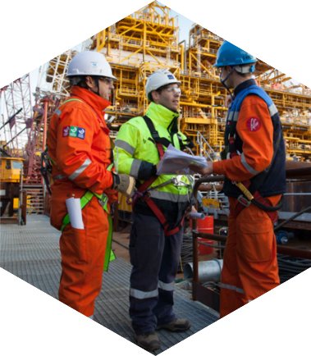
Joint safety tours (total & contractor):
Objectives:
Enable active listening
Visible management in the field.
Total and contractors sharing safety value through one ritual.
Workforce share their difficulties.
Common challenges to overcome:
Management availability
Coordination of visits
How to conduct it?

Slide 9
Simple & practical initiative
→ Successful if kept simple
Few points of vigilance however :
Let’s start with the inventory of what already exists : visits and list of high risks activities
Coordination and logistics may be demanding
Planning and anticipation is a must
Keep existing practices (Safety Tours, Safety Contract Owners,…), tools and follow-up sheets
Involvement of middle management is critical
And it is not : an audit, an inspection, a review of HSE procedures

Slide 10
In short
In the field, not behind the screen
Together, Total with its partners
Focus on high risk works : fatalities of 2019 triggered this initiative
Keep it simple : start with the inventory of existing processes & use existing tools
A4 summary sheet & guide will be provided : currently under review

Slide 11
Life saving checks (field controls):
Objectives:
Operational excellence
More controls used to improve shortfalls
Peer pressure
Awareness of Total’s compliance with base rules
Challenges:
- Contractor controlling Total activities
- Proper knowledge to fill control checklists
- Publishing weekly comparative results
- Organization and time allowance

Slide 12
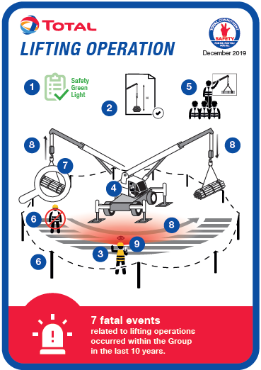
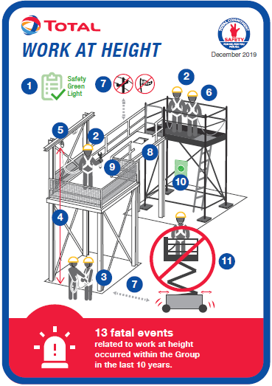
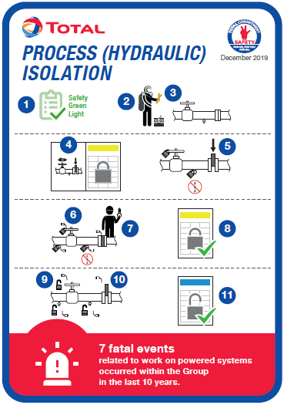
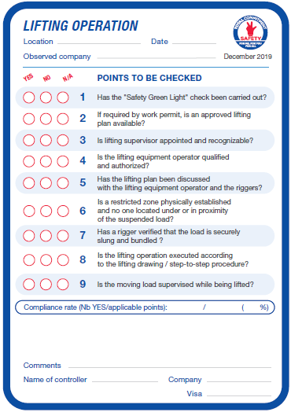
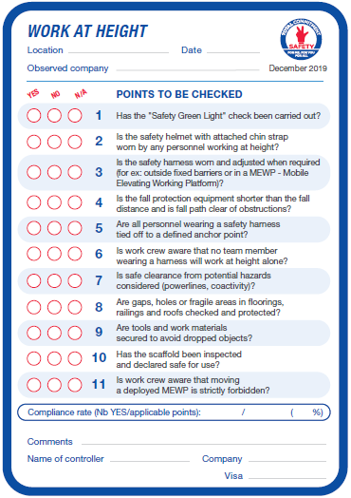
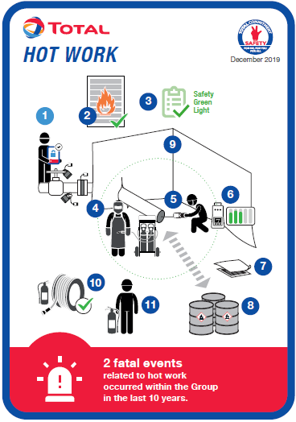
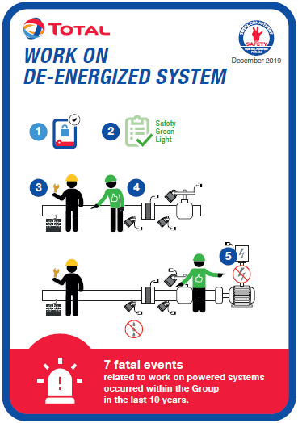
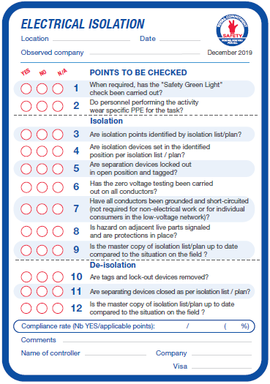
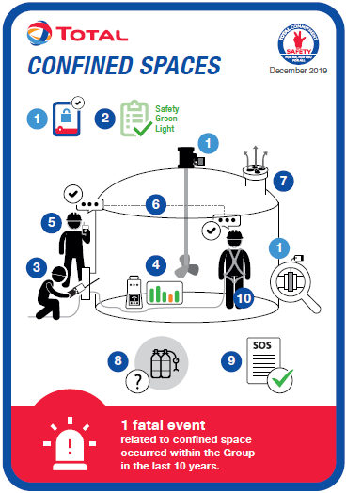
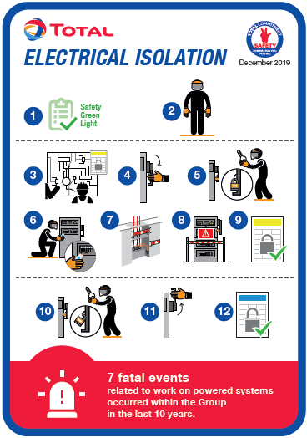
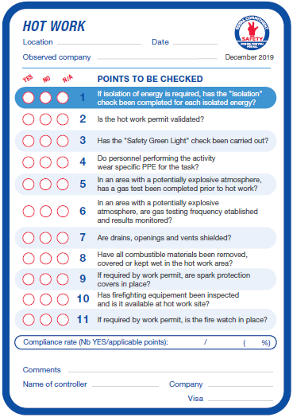
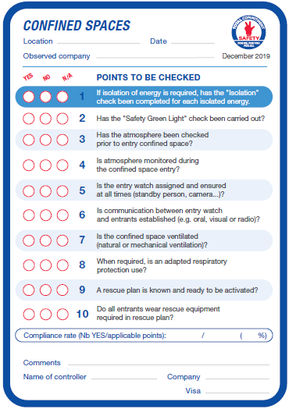
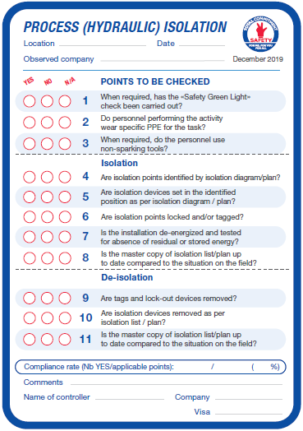
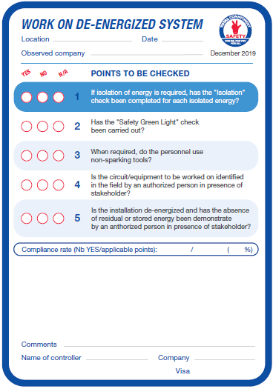
Tools
Checklists covering the top 5 life-threatening activities, with the diagram representing the activity on the front, and the points to check on the back.

Slide 13
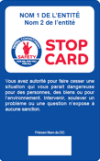
TOOLS
Example of a checklist:
Diagram representing the life-threatening activity and the points to check
Checklist of points to check on the life-threatening activity
Name of the observed company, not of the personnel involved
Numbered points to check, corresponding to the questions in the checklist
Non-compliant point
= stop
actvity
Reminder of the number of fatal accidents linked to the respective activity
Calculation of the compliance rate on the total of the points checked and applicable

Slide 14
In short

Slide 15
Three actions proposed
“Safety Greenlight”
Establish, as a part of the PTW, a Group-wide pre-work ritual focused on the prevention of fatal accidents
Joint Safety Tours
Generalize and increase the number of safety tours carried out with our Contractors
Life Saving Checks
Strengthen and increase on-site checks to measure compliance to our rules, with a view to strengthening fatal accident prevention
Communication Effort
Increase awareness on life-threatening hazards as well as support the implementation of proposed actions

